Slide 1
Natural Language Processing

Slide 2
Language Processor

Slide 3
Speech Recognition Disciplines
Signal Processing: Spectral analysis.
Physics (Acoustics): Study of Sound
Pattern Recognition: Data Clustering
Information Theory: Statistical Models
Linguistics: Grammar and Language Structures
Morphology: Language structure
Phonology: Classification of linguistic sounds
Semantics: Study of meaning
Pragmatics: How language is used
Physiology: Human Speech Production and Perception
Computer Science: Devise Efficient Algorithms
Note: Understanding of human speech recognition is rudimentary

Slide 4
Natural Language Applications
Phone and tablet applications
Dictation
Real time vocal tract visualization
Speaker identification and/or verification
Language translation
Robot interaction
Expert systems
Audio databases
Personal assistant
Audio device command and control

Slide 5
Application Requirements
Long-term benefit after the novelty wears off
Intuitive and easy to use
Easy recovery in presence of mistakes
Self-correction algorithms when possible
Verification before proceeding
Automatic transfer to human operator
Backup mode of communication (spell the command)
Accuracy of 95% or better in less than optimal environments
Real time response (250 MS or less)

Slide 6
Technical Issues
Language dependent or independent
Grammatical models (context, semantics, idioms)
Number of languages supported
Assessing meaning to words not in the dictionary
Available language-based resources
Consistently achieving 95% accuracy or better
Speech enhancement algorithms
Filtering background noise and transmission distortions
Voice activity detection
Detect boundaries between speech segments
Handling the slurring of words and co-articulation
Training requirements

Slide 7
Implementation Classifications

Slide 8
Speech Recognition
Why Hard?
SpEECH
A time-varying signal
Well-structured process
Limited, known physical movements
40-60 distinct units (phonemes) per language
Enhanced to overcome noise
⇒ should be easy!??
Speaker variations; accents
Changes in speed, loudness, and pitch
Environmental noise
Slurred, bad grammar
Fuzzy phoneme boundaries
Context-based semantics
Large vocabulary
Signal redundancies

Slide 9
The Noisy Channel
As easy on the mouth as possible to still be understood
What is this English sentence? “ay d ih s h er d s ah m th in ng ah b aw ya m uh v ih ng r ih s en l ih”
Where are the word boundaries?
The speech is slurred with grammar errors
Recognition is possible because:
We are sure of the phonetic components
We know the language (English)

Slide 10
Robot-human dialog
99% accuracy
Robo: “Hi, my name is Robo. I am looking for work to raise funds for Natural Language Processing research.”
Person: “Do you know how to paint?”
Robo: “I have successfully completed training in this skill.”
Person: “Great! The porch needs painting. Here are the brushes and paint.”
Robot rolls away efficiently. An hour later he returns.
Robo: “The task is complete.”
Person: “That was fast, here is your salary; good job, and come back again.”
Robo speaks while rolling away with the payment.
Robo: “The car was not a Porche; it was a Mercedes.”

Slide 11
Semantic Issues Sentence: “I made her duck”
I cooked waterfowl for her.
I stole her waterfowl and cooked it.
I created a living waterfowl for her.
I caused her to bid low in the game of bridge.
I created the plastic duck that she owns.
I caused her to quickly lower her head or body.
I waved my magic wand and turned her into waterfowl.
I caused her to avoid the test.
Eight possible meanings

Slide 12
How would a computer do?
I cdnuolt blveiee that I cluod aulaclty uesdnatnrd what I was rdgnieg.
The phaonmneal pweor of the hmuan mnid Aoccdrnig to rscheearch at Cmabridgde Uinervtisy, it deosn't mttaer in what oredr the ltteers in a word are, the olny iprmoatnt tihng is that the frist and lsat ltteer be in the rghit pclae.
The rset can be a taotl mses and you can still raed it wouthit a problem.
This is bcuseae the huamn mnid deos not raed ervey lteter by istlef, but the word as a wlohe.
Amzanig huh?
Yaeh and I awlyas thought slpeling was ipmorantt!

Slide 13
Language Components
Phoneme: Smallest discrete unit of sound that distinguishes words (Minimal Pair Principle)
Syllable: Acoustic component perceived as a single unit
Morpheme: Smallest linguistic unit with meaning
Word: Speaker identifiable unit of meaning
Phrase: Sub-message of one or more words
Sentence: Self-contained message derived from a sequence of phrases and words

Slide 14
Natural Language Characteristics
Phones: Set of all possible sounds that humans can articulate.
Each language selects a set of phonemes from the larger set of phones (English ≈ 40). Our hearing is tuned to respond to this smaller set.
Speech is a highly redundant sequential signal containing a sequence of sounds (phonemes) , pitch (prosody), gestures, and other expressions that vary with time.

Slide 15
The Speech Signal
A complex wave of varying atmospheric pressure traveling through space
The pressure is measured (sampled) at regular intervals to produce a digital array of amplitudes
Speech frequencies of interest are 100 to 3400 samples per second
The Nyquist theorem requires measurements of at least double the frequencies of interest

Slide 16
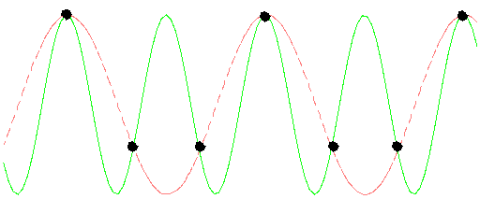
Nyquist Theorem
The sample rate must be at least twice the rate of the highest frequency of interest
Sampling at 1.5 times per cycle

Slide 17
Speech Signal Redundancy
Original Continuous Analog Signal
Virtually contains an infinite number of frequencies
Sampling Rates (Measurements per second)
Mac: 44,100 2-byte samples per second (705kbps)
PC: 16,000 2-byte samples per second (256kbps)
Telephone: 8k 1-byte sample per second (64kbps)
Compression for communication
Code Excited Linear Prediction Compression: 8kbps
Research: 4kbps, 2.4 kbps
Military applications: 600 bps
Human brain: 50 bps

Slide 18
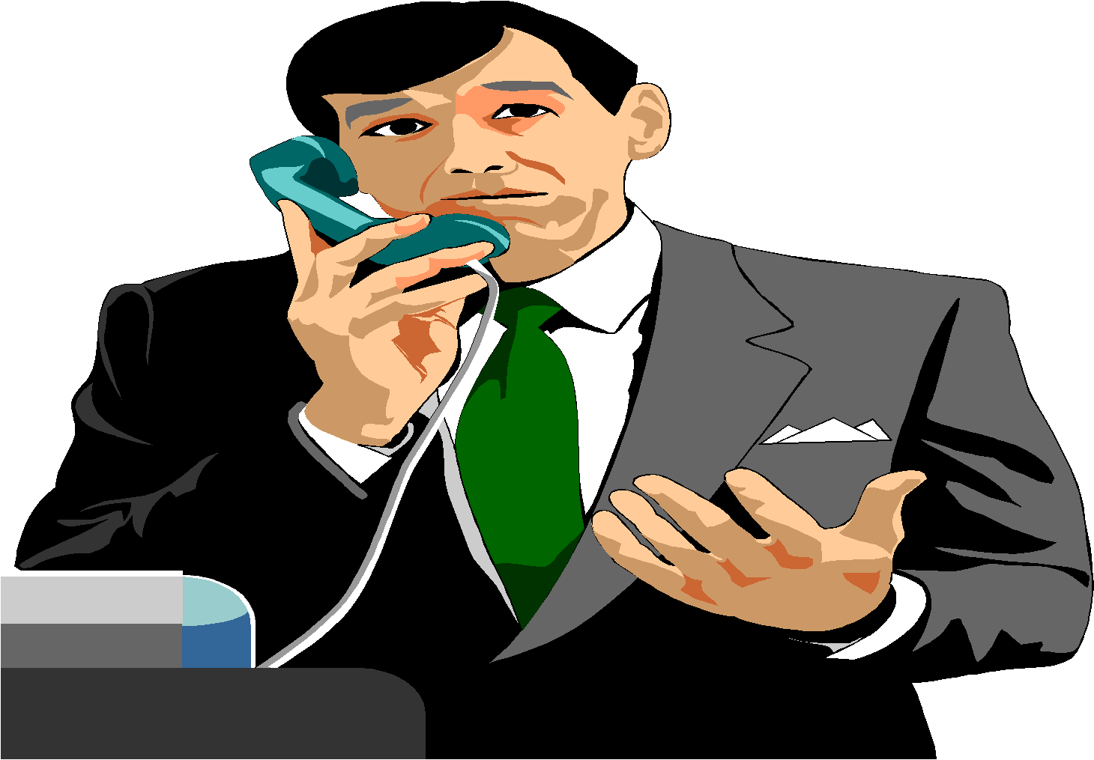
Speech Recognition
Speech
Recognition
Words
“How are you?”
Speech Signal
Goal: Automatically extract the string of words spoken from the speech signal

Slide 19
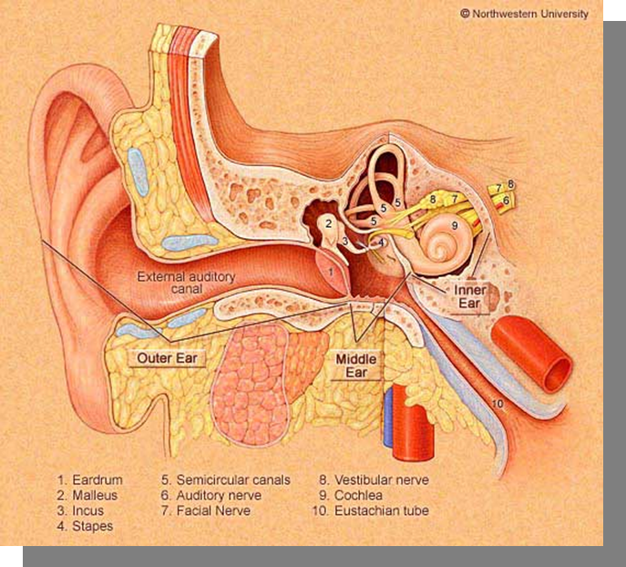
Speech Physiology
Acoustic Speech Signal
Perception
Production

Slide 20
Sound Transmission
ACORNS Sound Editor is Downloadable (ACORNS web-site)
Time Domain: 8k – 44.1k Samples per second
Top: “this is a demo” Bottom: “A goat …. A coat”

Slide 21
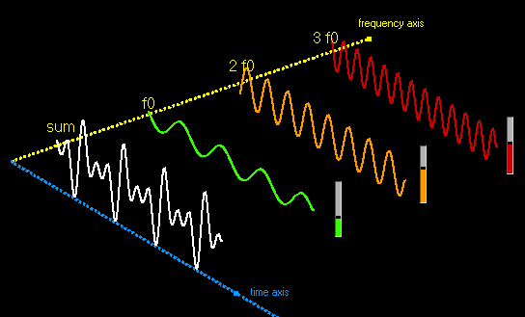
Time vs. Frequency Domain
Time Domain: Signal is a composite wave of different frequencies
Frequency Domain: Split time domain into the individual frequencies
Fourier: We can compute the phase and amplitude of each composite sinusoid
FFT: An efficient algorithm to perform the decomposition

Slide 22
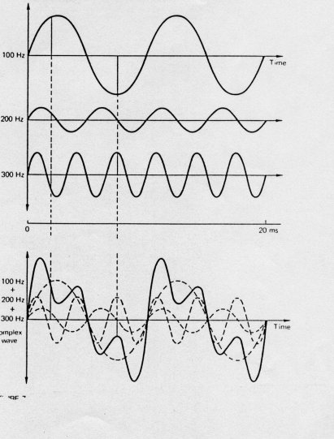
Complex Wave Patterns
Sine waves combine to form a new wave of a different shape
Every complex wave pattern consists of a series of composite sine waves
All of the composite sine are multiples of a basic frequency
Speech mostly consists of sinusoids combined together by linear addition

Slide 23
Frequency Domain
Audio: “This is a Demo”
Narrow band: Shows harmonics – horizontal lines
Harmonic definition: Integral multiple of a basic frequency
Wide Band: Shows pitch – pitch periods are vertical lines
Horizontal = time, vertical = frequency, frequency amplitude = darkness

Slide 24
Speech Recognition
Speech
Recognition
Words
“How are you?”
Acoustic Speech Signal
Input
Speech
Acoustic
Front-end
Acoustic Models
P(A|W)
Language Model
P(W)
Search
Recognized
Utterance
Processing
Language Model

Slide 25
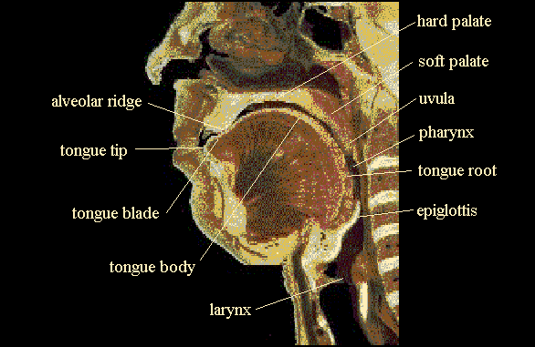
Vocal Tract (for Speech Production)
Note: Velum (soft palate) position controls nasal sounds, epiglottis closes when swallowing
Notes:
Labia: lips
Dental: teeth
Alveolar ridge: Area of angle change behind the teeth
Hard palate: The hard roof of the mouth
Soft palate: Soft area behind the hard palate
Uvula: Dangling fleshy soft tissue at the back of the soft palate
Pharynx: cavity between roof of tongue and walls of the upper throat
Tongue blade: flat surface of the tongue behind the tip
Tong body/dorsum: Main portion of tongue below the palates
Tongue root: portion of the tongue in the throat
Epiglottis: Fold of tissue just below the tongue root, covers the larynx when swallowing
Glottis: Opening between the vocal cords.
Larynx: The structure that manipulates the vocal cords

Slide 26
Another look at the vocal tract

Slide 27
Vocal Source
Speaker alters vocal tension of the vocal folds
Opened folds, speech is unvoiced resembling noise
If folds are stretched close, speech is voiced
Air pressure builds and vocal folds blow open releasing pressure and elasticity causes the vocal folds to fall back
Average fundamental frequency (F0): 60 Hz to 300 Hz
Speakers control vocal tension to alter F0 and the perceived pitch
Closed
Open
Period

Slide 28
Different Voices
Falsetto – The vocal cords are stretched and become thin causing high frequency
Creaky – Only the front vocal folds vibrate, giving a low frequency
Breathy – Vocal cords vibrate, but air is escaping through the glottis
Each person tends to consistently use particular phonation patterns. This makes the voice uniquely theirs

Slide 29
Place of the Articulation
Articulation: Shaping the speech sounds
Bilabial – The two lips (p, b, and m)
Labio-dental – Lower lip and the upper teeth (v)
Dental – Upper teeth and tongue tip or blade (thing)
Alveolar –Alveolar ridge + tongue tip or blade (d, n, s)
Post alveolar –Area just behind the alveolar ridge and tongue tip or blade (jug ʤ, ship ʃ, chip ʧ, vision ʒ)
Retroflex – Tongue curled and back (rolling r)
Palatal – Tongue body touches the hard palate (j)
Velar – Tongue body touches soft palate (k, g, ŋ (thing))
Glottal – larynx (uh-uh, voiced h)

Slide 30
Manner of Articulation
Voiced: The vocal cords are vibrating, Unvoiced: vocal cords don’t vibrate
Obstruent: Frequency domain is similar to noise
Fricative: Air flow not completely shut off
Affricate: A sequence of a stop followed by a fricative
Sibilant: a consonant characterized by a hissing sound (like s or sh)
Trill: A rapid vibration of one speech organ against another (Spanish r).
Aspiration: burst of air following a stop.
Stop: Air flow is cut off
Ejective: airstream and the glottis are closed and suddenly released (/p/).
Plosive: Voiced stop followed by sudden release
Flap: A single, quick touch of the tongue (t in water).
Nasality: Lowering the soft palate allows air to flow through the nose
Glides: vowel-like, syllable position makes them short without stress (w, y). An On-glide is a glide before a vowel; an off-glide is a glide after vowel
Approximant (semi-vowels): Active articulator approaches the passive articulator, but doesn’t totally shut of (L and R).
Lateral: The air flow proceeds around the side of the tongue

Slide 31
Vowels
No restriction of the vocal tract, articulators alter the formants
Diphthong: Syllabics which show a marked glide from one vowel to another, usually a steady vowel plus a glide
Nasalized: Some air flow through the nasal cavity
Rounding: Shape of the lips
Tense: Sound more extreme (further from the schwa) and tend to have the tongue body higher
Relaxed: Sounds closer to schwa (tonally neutral)
Tongue position: Front to back, high to low
Schwa: unstressed central vowel (“ah”)

Slide 32
Consonants
Significant obstruction in the nasal or oral cavities
Occur in pairs or triplets and can be voiced or unvoiced
Sonorant: continuous voicing
Unvoiced: less energy
Plosive: Period of silence and then sudden energy burst
Lateral, semi vowels, retroflex: partial air flow block
Fricatives, affricatives: Turbulence in the wave form

Slide 33
English Consonants
Type | Phones | Mechanism
Plosive | b,p,d,t,g,k | Close oral cavity
Nasal | m, n, ng | Open nasal cavity
Fricative | v,f,z,s,dh,th,zh, sh | Turbulent
Affricate | jh, ch | Stop + Turbulent
Retroflex Liquid | r | Tongue high and curled
Lateral liquid | l | Side airstreams
Glide | w, y | Vowel like

Slide 34
Consonant Place and Manner
 | Labial | Labio-dental | Dental | Aveolar | Palatal | Velar | Glottal
Plosive | p b |  |  | t d |  | k g | ?
Nasal | m |  |  | n |  | ng
Fricative |  | f v | th dh | s z | sh zh |  | h
Retroflex sonorant |  |  |  | r
Lateral sonorant |  |  |  | l
Glide | w |  |  |  | y

Slide 35
Example word

Slide 36
Speech Production Analysis
Devices used to measure speech production
Plate attached to roof of mouth measuring contact
Collar around the neck measuring glottis vibrations
Measure air flow from mouth and nose
Three dimension images using MRI
Note: The International Phonetic Alphabet (IPA) was designed before the above technologies existed. They were devised by a linguist looking down someone’s mouth or feeling how sounds are made.

Slide 37
ARPABET: English-based phonetic system
Phone Example Phone Example Phone Example
[iy] beat [b] bet [p] pet
[ih] bit [ch] chet [r] rat
[eh] bet [d] debt [s] set
[ah] but [f] fat [sh] shoe
[x] bat [g] get [t] ten
[ao] bought [hh] hat [th] thick
[ow] boat [hy] high [dh] that
[uh] book [jh] jet [dx] butter
[ey] bait [k] kick [v] vet
[er] bert [l] let [w] wet
[ay] buy [m] met [wh] which
[oy] boy [em] bottom
[arr] dinner [n] net [y] yet
[aw] down [en] button [z] zoo
[ax] about [ng] sing [zh] measure
[ix] roses [eng] washing
[aa] cot [-] silence

Slide 38
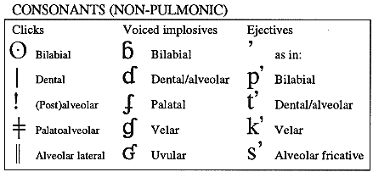
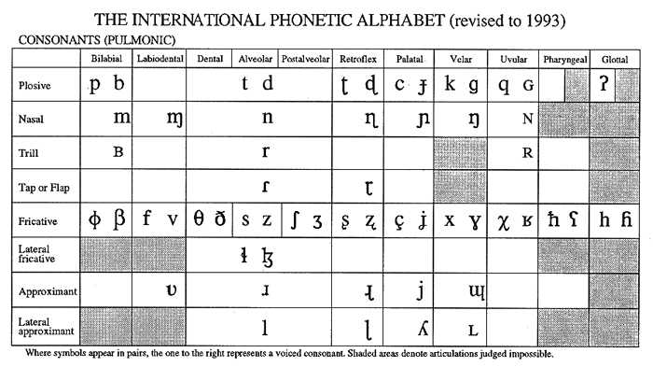
The International Phonetic Alphabet
A standard that attempts to create a notation for all possible human sounds

Slide 39
IPA Vowels
Caution: American English tongue positions don’t exactly match the chart. For example, ‘father’ in English does not have the tongue position as far back as the IPA vowel chart shows.

Slide 40
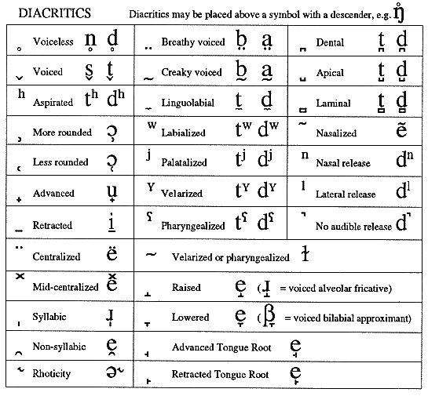
IPA Diacritics

Slide 41
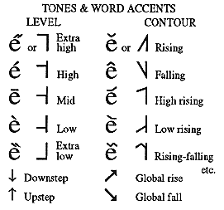
IPA: Tones and Word Accents

Slide 42
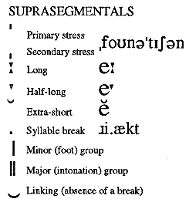
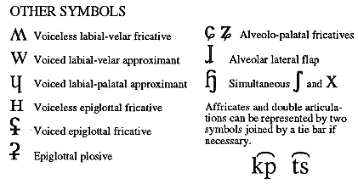
IPA: Supra-segmental Symbols

Slide 43
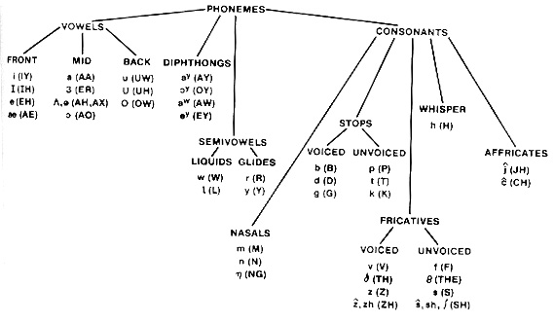
Phoneme Tree Categorization
from Rabiner and Juang

Slide 44
Characteristics: Vowels & Diphthongs
Vowels
/aa/, /uw/, /eh/, etc.
Voiced speech
Average duration: 70 msec
Spectral slope: higher frequencies have lower energy (usually)
Resonant frequencies (formants) at well-defined locations
Formant frequencies determine the type of vowel
Diphthongs
/ay/, /oy/, etc.
Combination of two vowels
Average duration: about 140 msec
Slow change in resonant frequencies from beginning to end

Slide 45
Perception
Some perceptual components are understood, but knowledge concerning the entire human perception model is rudimentary
Understood Components
The inner ear works as a bank of filters
Sounds are perceived logarithmically, not linearly
Some sounds will mask others

Slide 46
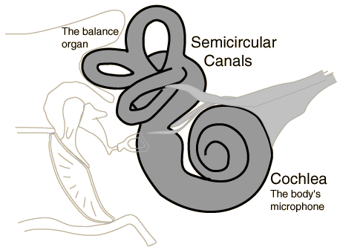
The Inner Ear
Two sensory organs are located in the inner ear.
The vestibule is the organ of equilibrium
The cochlea is the organ of hearing

Slide 47
Hearing Sensitivity Frequencies
Human hearing is sensitive to about 25 ranges of frequencies
Cochlea transforms pressure variations to neural impulses
Approximately 30,000 hair cells along basilar membrane
Each hair cell has hairs that bend to basilar vibrations
High-frequency detection is near the oval window.
Low-frequency detection is at far end of the basilar membrane.
Auditory nerve fibers are ``tuned'' to center frequencies.

Slide 48
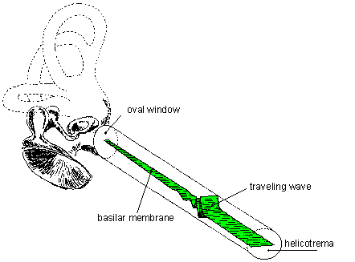
Basilar Membrane
Note: Basilar Membrane shown unrolled
Thin elastic fibers stretched across the cochlea
Short, narrow, stiff, and closely packed near the oval window
Long, wider, flexible, and sparse near the end of the cochlea
The membrane connects to a ligament at its end.
Separates two liquid filled tubes that run along the cochlea
The fluids are very different chemically and carry the pressure waves
A leakage between the two tubes causes a hearing breakdown
Provides a base for sensory hair cells
The hair cells above the resonating region fire more profusely
The fibers vibrate like the strings of a musical instrument.

Slide 49
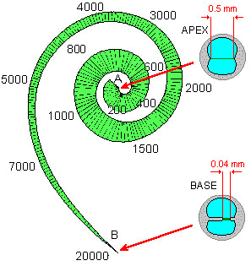
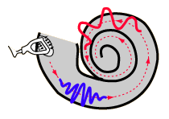
Place Theory
Decomposing the sound spectrum
Georg von Bekesy’s Nobel Prize discovery
High frequencies excite the narrow, stiff part at the end
Low frequencies excite the wide, flexible part by the apex
Auditory nerve input
Hair cells on the basilar membrane fire near the vibrations
The auditory nerve receives frequency coded neural signals
A large frequency range possible; basilar membrane’s stiffness is exponential
Demo at: http://www.blackwellpublishing.com/matthews/ear.html

Slide 50
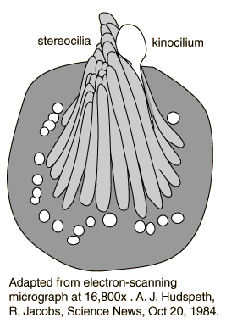
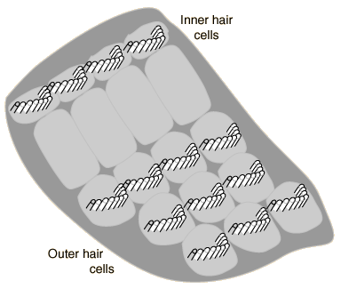
Hair Cells
The hair cells are in rows along the basilar membrane.
Individual hair cells have multiple strands or stereocilia.
The sensitive hair cells have many tiny stereocilia which form a conical bundle in the resting state
Pressure variations cause the stereocilia to dance wildly and send electrical impulses to the brain.

Slide 51
Firing of Hair Cells
There is a voltage difference across the cell
The stereocilia projects into the endolymph fluid (+60mV)
The perylymph fluid surrounds the membrane of the haircells (-70mV)
When the hair cells moves
The potential difference increases
The cells fire

Slide 52
Frequency Perception
We don't perceive speech linearly
Cochlea hair cell rows act as frequency filters
The frequency filters overlap
From early place theory experiments

Slide 53
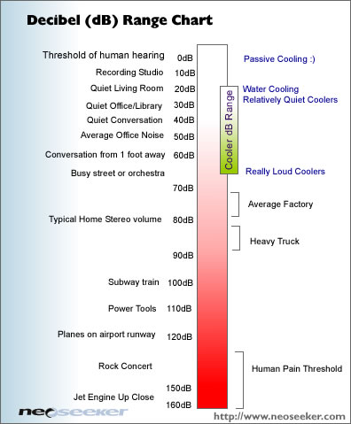
Sound Pressure Level (SPL)
Sound | dB
TOH | 0
Whisper | 10
Quiet Room | 20
Office | 50
Normal conversation | 60
Busy street | 70
Heavy truck traffic | 90
Power tools | 110
Pain threshold | 120
Sonic boom | 140
Permanent damage | 150
Jet engine | 160
Cannon muzzle | 220

Slide 54
Absolute Hearing Threshold
The hearing threshold varies at different frequencies
Empirical formula to approximate the SPL threshold: SPL(f) = 3.65(f/1000)^{-0.8}-6.5e^{-0.6(f/1000-3.3)^2}+10⁻³(f/1000)⁴
Hearing threshold for men (M) and women (W) ages 20 through 60

Slide 55
Sound Threshold Measurements
MAF = Minimum Audio Frequency
Note: The lines indicate the perceived DB relative to SPL for various frequencies

Slide 56
Auditory Masking
A sound masks another sound that we can normally hear
Frequency Masking (sounds close in frequency)
a sound masked by a nearby frequency.
Lossy sound compression algorithms makes use of this
The temporal masking (sounds close in time)
Strong sound masks a weaker sound with similar frequency
Masking amount depends on the time difference
Forward Masking (earlier sound masks a later sound)
Backward Masking (later sound masks an earlier one)
Noise Masking (noise has random frequency range)
Noise masks all frequencies.
All speech frequencies must be increased to decipher
Filtering of noise is required for speech recognition

Slide 57
Time Domain Masking
Noise will mask a tone if:
The noise is sufficiently loud
The time difference is short
Greater intensity increases masking time
There are two types of masking
Forward: Noise masking a tone that follows
Backward: A tone is masked by noise that follows
Delays
beyond 100 − 200 ms no forward masking occurs
Beyond 20 ms, no backward masking occurs. Training can reduce or eliminate the perceived backward masking

Slide 58
Masking Patterns
Experiment
Fix one sound at a frequency and intensity
Vary a second sine wave’s intensity
Measure when the second sound is heard
From CMU Robust
Speech Group
A narrow band of noise at 410 Hz

Slide 59
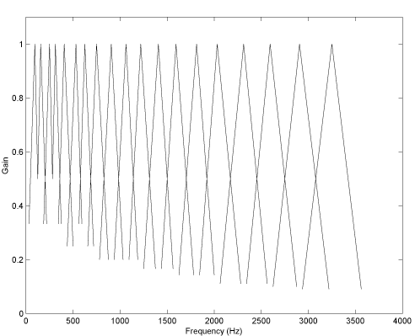
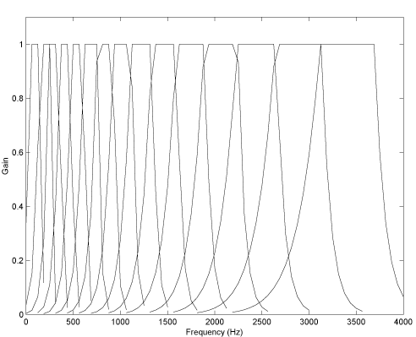
Psychoacoustics
Analyze audio according to human hearing sensitivity
Mel scale: Bark scale:
Formulas to convert linear frequencies to MEL and BARK frequencies
Apply an algorithm to mimic the overlapping cochlea rows of hair cells

Slide 60
Mel Scale Algorithm
Apply the MEL formula to warp the frequencies from the linear to the MEL scale
Triangle peaks are evenly spaced through the MEL scale for however number of MEL filters desired
Start point of one triangle is the middle of the previous
End point to middle equals start point to middle
Sphinx speech recognizer: Height is 2/(size of un-scaled base)
Perform weighted sum to fill up filter bank array

Slide 61
Frequency Perception Scale Comparison
Blue: Bark Scale
Red: Mel Scale
Green: ERB Scale
Equivalent Rectangular Bandwidth (ERB) is an unrealistic but
simple rectangular approximation to model the filters in the cochlea

Slide 62
Formants
F0: Vocal cord vibration frequency (pitch)
Averages: Male = 100 Hz, Female = 200 Hz, Children = 300 Hz
F1, F2, F3: Fundamental frequency harmonics
Varies depending on vocal tract shape and length
Articulators to the back brings formants together
Articulators to the front moves formants apart
Roundness impacts the relationship between F2 and F3
Spreads out as the pitch increases
Adds timbre (quality other than pitch or intensity) to voiced sounds
Advantage: Excellent feature for distinguishing vowels
Disadvantage: Not able to distinguishing unvoiced sounds

Slide 63
Formant Example
“a” from “this is a demo”
Note: The vocal fold vibration is somewhat noisy, (a combination of frequencies)

Slide 64
Formant Speaker Variance
Peterson and Barney recorded 76 speakers at the 1939 World’s Fair in New York City, and published their measurements of the vowel space in 1952.

Slide 65
Vowel Characteristics
Demo of Vowel positions in the English language
http://faculty.washington.edu/dillon/PhonResources/vowels.html
Demo: http://faculty.washington.edu/dillon/PhonResources/vowels.html
Vowel | Word | high | Low | front | back | round | tense | F1 | F2
Iy | Feel | + | - | + | - | - | + | 300 | 2300
Ih | Fill | + | - | + | - | - | - | 360 | 2100
ae | Gas | - | + | + | - | - | + | 750 | 1750
aa | Father | - | + | - | - | - | + | 680 | 1100
ah | Cut | - | - | - | - | - | + | 720 | 1240
ao | Dpg | - | - | - | - | - | - | 600 | 900
ax | Comply | - | - | + | - | - | - | 720 | 1240
eh | Pet | - | - | - | + | + | + | 570 | 1970
ow | Tone | + | - | - | + | - | - | 600 | 900
uh | Good | + | - | - | + | - | + | 380 | 950
uw | Tool |  |  |  |  |  |  | 300 | 940

Slide 66
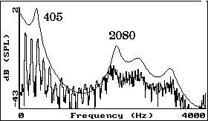
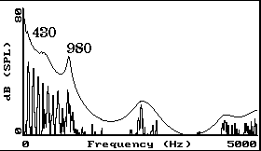
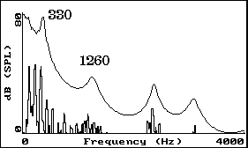
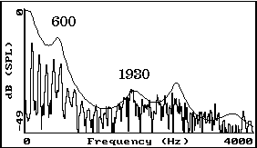
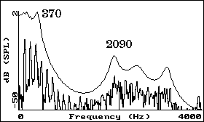
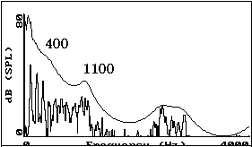
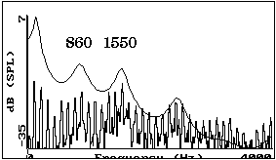
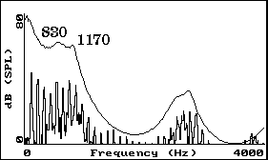
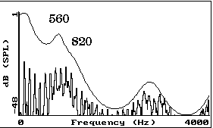
Vowel Formants
u
e
o
eh
ih
uh
ae
ah
aw

Slide 67
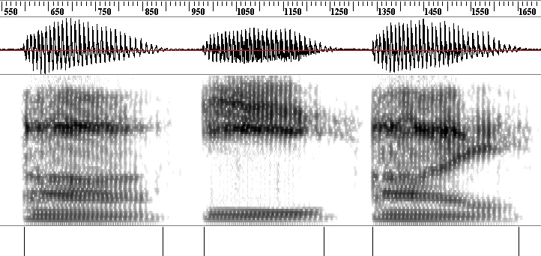
Frequency Domain: Vowels & Diphthongs
/ah/: low, back
/iy/: high, front
/ay/: diphthong

Slide 68
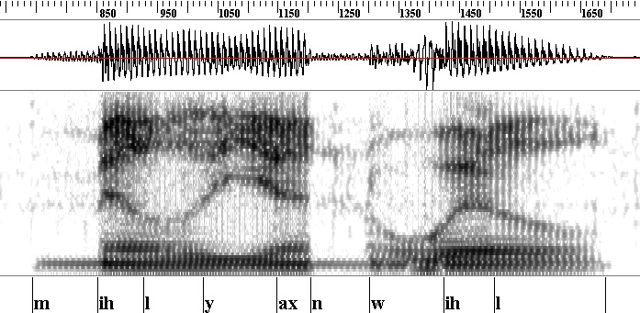
Frequency Domain: Nasals
Nasals
/m/, /n/, /ng/
Voiced speech
Spectral slope: higher frequencies have lower energy (usually)
Spectral anti-resonances (zeros)
Resonances and anti-resonances often close in frequency.

Slide 69
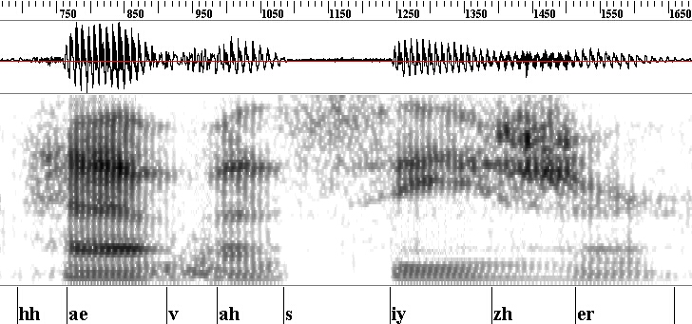
Frequency Domain: Fricatives
Fricatives
/s/, /z/, /f/, /v/, etc.
Voiced and unvoiced speech (/z/ vs. /s/)
Resonant frequencies not as well modeled as with vowels

Slide 70
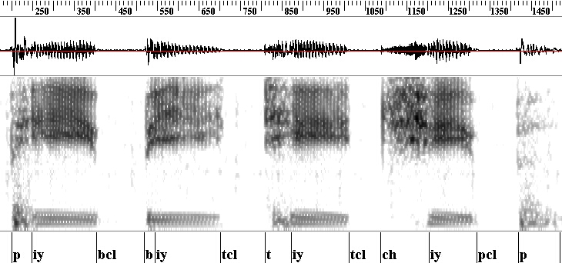
Frequency Domain: Plosives (Stops) & Affricates
Plosives
/p/, /t/, /k/, /b/, /d/, /g/
Sequence of events: silence, burst, frication, aspiration
Average duration: about 40 msec (5 to 120 msec)
Affricates
/ch/, /jh/
Plosive followed immediately by fricative

