Slide 1
Speech Recognition Frameworks
Front End (Eliminate Redundancies)
Digital Signal Processing
Pre-process the audio signal to enhance speech and remove noise
Extract relevant information for further processing
Back End (Recognition Algorithms)
Phonetic labeling
Pattern classification after training
Statistical pattern-recognition
Grammatical modeling for particular languages
Dictionary data bases

Slide 2
Definitions
Semi-stationary: Speech is a slowly changing (semi-stationary) signal considered to be static in a 20-50 MS time interval
Frame: A 20-50 MS portion of an audio signal
Feature: A calculated attribute of a speech frame
Window: An algorithm to smooth the edges of a frame
Noise: Artifacts in a signal that degrade its clarity

Slide 3
Front End (Signal Processing)
Resample the simple to match the speech database sample rate
Filter noise
Enhance speech characteristics in the signal
Separate silence from speech; possibly detect phoneme boundaries
Partition into overlapping frames (about 25 MS with a 50% overlap)
For each frame
Apply windowing algorithm to each frame to smooth edges
Extract time domain features from the raw signal
Extract frequency domain features after applying transformations to match human perception
Possibly apply temporal smoothing algorithms
Possibly transform the data to reduce the number of features
Feature normalization (mean to 0, variance to 1)

Slide 4
Acoustic Modeling: Feature Extraction Ecample
Fourier
Transform
Incorporate knowledge of the
nature of speech sounds in
measurement of the features.
Utilize rudimentary models of
human perception.
Input Speech
Measure features 100 times per sec.
Use a 25 MS window for frequency domain analysis.
Include absolute energy and 12 spectral measurements.
Time derivatives to model spectral change.
Cepstral
Analysis
Perceptual
Weighting
Time
Derivative
Time
Derivative
Energy
+
Mel-Spaced Cepstrum
Delta Energy
+
Delta Cepstrum
Delta-Delta Energy
+
Delta-Delta Cepstrum

Slide 5
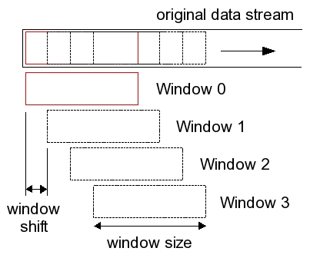
Speech Frames
Goal: Extract short-term signal features from speech signal frames
Breakup speech signal into overlapping frames
Why?
Speech is quasi-periodic, not periodic, because vocal musculature is always changing
Within a small window of time, we can assume constancy
Frame
Frame
Frame
Frame
Frame
shift
Frame size
Typical Characteristics
10-30 MS length
1/3 – 1/2 overlap

Slide 6
Feature Extraction
Goal: Remove redundancies by representing a frame by its feature “fingerprint”
Definitions
Feature: A calculated attribute of a speech signal
Phoneme: The smallest phonetic unit that distinguishes words
Morpheme: The smallest phonetic unit that conveys meaning
Feature Extraction: Algorithm to convert a captured audio into a useable form for decoding
Feature Vector: List of values representing a given signal frame
Process
Signal Conditioning (digitizing a signal)
Signal Measurement (compute signal amplitudes)
Enhance (perform perceptual augmentations)
Conversion (Convert data into a feature vector)
Challenge: Choose a relevant and computationally efficient feature set

Slide 7
Principle Component Analysis
Feature Dimension Reduction
Normalize the mean of the data set to zero
Calculate the covariance matrix and calculate the eigenvectors (v) and eigenvalues (λ) of that matrix
Av = λv (ex: $\left(\begin{matrix}2 & 3 \\ 2 & 1\end{matrix}\right)\left(\begin{matrix}3 \\ 2\end{matrix}\right)= \left(\begin{matrix}12 \\ 8\end{matrix}\right)=4 ∗\left(\begin{matrix}3 \\ 2\end{matrix}\right)$
Sort the eigenvectors (V_{i}) by eigenvalues
Pick the largest eigenvectors and discard those that remain.
Transform the data to a reduced dimension by performing a dot product (fNew_{p} = $\sum_{f=0}^{F−1}{dataf ∗Vp, f}$)

Slide 8
Which Audio Features?
Cepstrals: They are statistically independent and phase differences are removed
ΔCepstrals, or ΔΔCepstrals: Reflects how the signal is changing from one frame to the next
Energy: Distinguish the frames that are voiced verses those that are unvoiced
Normalized LPC Coefficients: Represents the shape of the vocal track normalized by vocal tract length for different speakers.
These are some of the popular speech recognition features

Slide 9
Signal Processing Processing
Acoustic Transducers: Convert sound into an electronic signal which is then digitized
Sampling and Resampling: Down or up sample for compatibility with stored audio templates
Band pass filter: Eliminate frequencies that don’t contain useful speech information
Time Domain Analysis: Extract time domain features
Frequency Domain Analysis: Extract frequency domain features
Spectral Normalization: Apply Mel or Bark scale frequency transformations
Cepstral Analysis or Linear Prediction: Each have a well-defined set of steps
Feature Normalization: Normalize the mean, variance respectively to zero and one. Optionally nomalize the higher statistical moments.

Slide 10
Speech Recognition Front End
Assume resampling is already done
Speech
Frame
Pre-emphasis
windowing
Time Domain
Features
Spectral Analysis
Frequency
Features
Enhance and Consolidate Features
Feature
Vector
(Frame by feature array)

Slide 11
Pre-emphasis
Human Audio
There is an attenuation of the audio signal loudness as it travels along the cochlea, which makes humans require less amplitudes in the higher frequencies
Speech high frequencies have initial less energy than low frequencies
De-emphasizing the lower frequencies compared to is closer to the way humans hear
Pre-emphasis Algorithm
Pre-emphasis recursive filter de-emphasizes lower frequencies
Formula: Y[i] = X[i] - (X[i-1] * δ)
0.95 to 0.97 are common defaults for δ
0.97 de-emphasizes lower frequencies more than 0.95

Slide 12
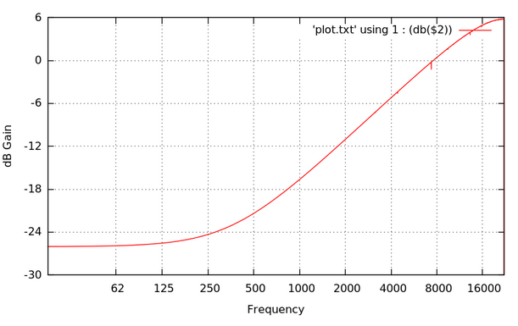
Pre-emphasis Filter
y[i] = x[i] – x[i-1] * 0.95

Slide 13
Windowing
Problem: Framing a signal results in abrupt edges
Impact
There is significant spectral leakage in the frequency domain
Large side lobe amplitudes
Effect of Windowing
There are no abrupt edges
Minimizes side lobe amplitudes and spectral leakage
How? Apply a window formula in the time domain (which is a simple for loop)
Definitions
Frame: A small portion (sub-array) of an audio signal
Window: A frame to which a window function is applied

Slide 14
Window Types for Speech
Rectangular: w_{k} = 1 where k = 0 … N
The Naïve approach
Advantage: Easy to calculate, array elements unchanged
Disadvantage: Messes up the frequency domain
Hamming: w_{k} = 0.54 – 0.46 cos(2kπ/N-1))
Advantage: Fast roll-off in frequency domain, popular for ASR
Disadvantage: worse attenuation in stop band
Blackman: w_{k} = 0.42 – 0.5 cos(2kπ/(N-1)) + 0.08 cos(4kπ/(N-1))
Advantage: better attenuation, popular for ASR
Disadvantage: wider main lobe
Hanning: w_{k} = 0.5 – 0.5 cos(2kπ/N-1))
Advantage: Useful for pitch transformation algorithms
Multiply the window, point by point, to the audio frame

Slide 15
Create and Apply Hamming Window
public double[] createHammingWindow(int filterSize)
{ double[] window = new double[filterSize];
double c = 2*Math.PI / (filterSize - 1);
for (int h=0; h<filterSize; h++)
window[h] = 0.54 - 0.46*Math.cos(c*h);
return window;
}
public double[] applyWindow(double[] window, double[] signal)
{ for(int i=0; i<window.length; i++) signal[i] = signal[i]*window[i];
return samples;
}

Slide 16
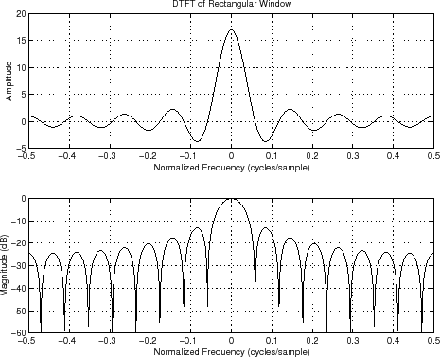
Rectangular Window Frequency Response
Time Domain Filter

Slide 17
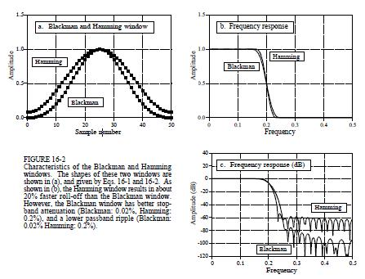
Blackman & Hamming Frequency Response

Slide 18
Time domain Features
Advantages: less processing; usually easy to understand
Examples
Energy
Zero-crossing rate
Auto correlation and auto differences
Pitch period
Fractal Dimension
Linear Prediction coefficients
Note: These features can directly be obtained from the raw signal

Slide 19
Signal Energy
Useful to determine if a windowed frame contains a voiced speech
Calculate the short term frame energy
Energy = ∑_{k=0,N} (s_{k})² where N is the size of the frame
Represent result in decibels relative to SPL db = 10 log(energy)
Tradeoffs
If window is too small: too much variance
If window is too big: encompasses both voiced and unvoiced speech
Voiced speech has higher energy than unvoiced speech or silence
Changes in energy can indicate stressed syllables (loudness contour)

Slide 20
Zero Crossings
Eliminate a possible DC component, meaning every measurement is offset by some value
Average the absolute amplitudes ( 1/M ∑ _{0,M-1}s_{k} )
Subtract the average from each value
Count the number of times that the sign changes
∑_{0,M-1}0.5|sign(s_{k})-sign(s_{k-1})|; where sign(x) = 1 if x≥0, -1 otherwise
Note: |sign(s_{k})-sign(s_{k-1})| equals 2 if it is a zero crossing
Unvoiced speech tends to have higher zero crossing than background noise

Slide 21
Pitch detection
Determine self-similarity of a signal
Question: How well does a signal correlate with an offset version of itself?
Apply the auto-correlation formula
R = ∑_{i=1,n-z} x_{f}[i]x_{f}[i+offset]/∑_{i=1,F} x_{f}[i]²
Apply the auto-difference formula
D = ∑_{i=1,n-z} Math.abs(x_{f}[i] - x_{f}[i+offset])
Either method is useful for determining the pitch of a signal. We would expect that R is maximum (and D minimum) when offset corresponds to that of the pitch period

Slide 22
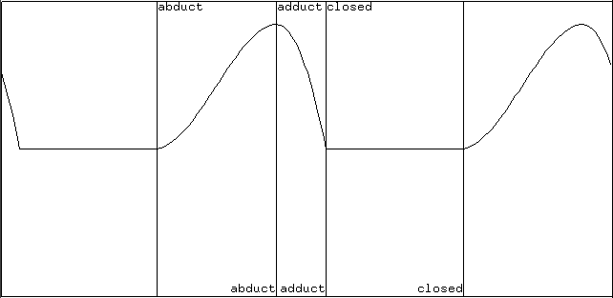
Vocal Source
Speaker alters vocal tension of the vocal folds
If folds are opened, speech is unvoiced resembling background noise
If folds are stretched close, speech is voiced
Air pressure builds and vocal folds blow open releasing pressure and elasticity causes the vocal folds to fall back
Average fundamental frequency (F0): 60 Hz to 300 Hz
Speakers control vocal tension alters F0 and the perceived pitch
Closed
Open
Pitch Period

Slide 23
Fractal Dimension
Definition: The self-similarity of a signal
Comments
There are various methods to compute a signal’s self-similarity, which each lead to different results
Each method is empirical, not backed by mathematics
Some popular algorithms
Box Counting
Katz
Higuchi
Importance: We would expect that the self-similarity of speech, because it is constrained by the larynx and vocal tract, to be different than that of background noise

Slide 24
Box Counting Algorithm
Assume signal[i] is an array of audio amplitudes, where each sample represents t milliseconds
delta = 1
FOR i = 0 to S
delta = 2^i
Cover the curve with rectangles: h = signal[i+delta] – signal[i], w = delta * t
Fractal[i] = count of rectangles needed to cover the curve
Perform a linear regression on the Fractal array
The slope of the best fit line is the fractal dimension

Slide 25
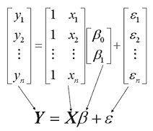
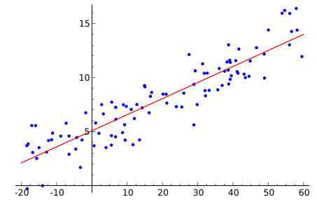
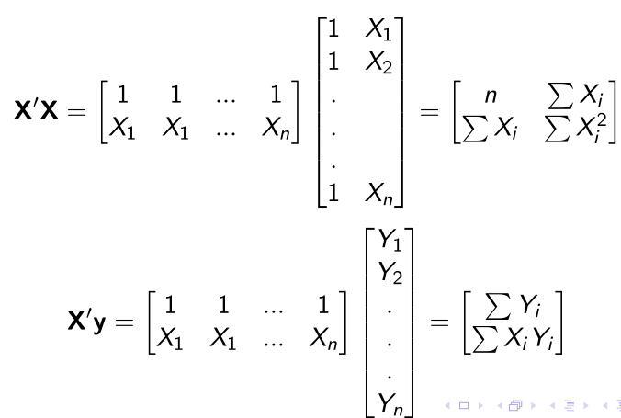
Linear Regression
Set of points: (x₁,y₁), (x₂,y₂), … (x_{N},y_{N})
Equations: Find b₀ + b₁x₁ that minimizes errors where Y_{i} = b₀+b₁x_{i}+e_{i}
Goal: Find slope b₁ of the best fit line
Assumption: the expected value (mean) of the errors is zero
Note: X’ is transpose of X, -1 is inverse

Slide 26
Best Fit Slope of x amplitudes
bestFit(double[] y)
{ int MAX = y.length;
// Compute the X’X matrix (a_{ij})
double d = MAX*(MAX+1)*(2*MAX+1)/6; // ∑ x_{i}² = d
double b = MAX * (MAX + 1) / 2; // ∑ x_{i} = b = c
double c = b, a = MAX; // number of points
double sumXY=0, sumY=0; // Compute ∑ y_{i} and sum ∑ x_{i} * y_{i} b_{i} = X’y
for (int i=0; i<MAX; i++) { sumXY += (i+1) * y[i]; sumY += y[i]; }
// Return (X’X)⁻¹ * X’y, where (X’X)⁻¹ is the inverse of X’X
double numerator = -c*sumY + a*sumXY ; // -c*sumXY+a*sumY
double denominator = d * a – b * c; // ad - bc
return (denominator == 0) ? 0 : numerator / denominator; // Slope
}
Assuming that the x points are 1, 2, 3, …
Method returns b₁ of y = b₀ + b₁x
Note:

Slide 27
Katz Fractal Dimension
Dimension = log(sum of lengths)/log(largest distance from the first point)
double katz(double[] x)
{ int N = x.length;
if (N<=1) return 0;
double L=0, diff=0, D=0;
for (int i=1; i<x.length; i++)
{ L += Math.abs(x[i] - x[i-1]);
diff = Math.abs(x[0] – x[i]);
if (diff > D) D = diff;
}
double log = Math.log10(N-1);
return (d==0)?0:log/(Math.log10(d/L)+log);
}
L = ∑ x_{i} – x_{i-1} (sums adjacent lengths)
max, min = from first point
Katz normalizes log(L)/log(D)) to use log(L/d)/log(D/d)
Final formula log(L/d)/log(D/d) =
log(N - 1) / log(D/(L/(N-1))) =
log(N-1) / (log(D/m) + log(N-1))
Notes
N-1 because there are N-1 intervals with a signal of N points
L / d = L / (L/(N-1)) = N-1

Slide 28
Higuchi Fractal Dimension

Slide 29
Higuchi Fractal Dimension (cont)
double Lk(double[] x, int k)
{ double sum = 0;
for (int m=1; m<=k; m++)
{ sum += LmK(x, m, k); }
return sum / k;
}
double LmK(double[] x, int m, int k)
{ int N = x.length;
double sum = 0;
for (int i=1; i<=(N-m)/k; i++)
{ sum += Math.abs
(x[m-1+i*k]-x[m-1+(i-1)*k]);
}
return sum * (N - 1) / ((N - m)/k * k);
}
public double higuchi (double[] x)
{ int MAX = x.length/4;
double[] L = new double[MAX];
for (int k=1; k<=MAX; k++)
{ L[k-1] = Lk(x, k)/k; }
// Find least squares linear best fit of L
double slope = bestFit(L, MAX) + 1e-6;
return Math.log10(Math.abs(slope));
}

Slide 30
Linear Prediction Coding (LPC)
Originally developed to compress (code) speech
Although coding pertains to compression, LPC has much broader implications
LPC is equivalent to the tubal model of the vocal tract model
LPC can be used as a filter to reduce noise (Wiener filter) from a signal
A speech frame can be approximated with a set of LPC coefficients
one coefficient per 1k of sample rate + 2
Example: For a 10k sample, 12 LPC coefficients are sufficient
LPC speech recognition is somewhat noise resilient

Slide 31
Illustration: Linear Prediction
{1, 2, 3, 4, 5, 6, 7, 8, 9, 10, 11, 12, 13, 14, 15, 16}
Goal: Estimate y_{n} using the three previous values
y_{n} ≈ a₁ y_{n-1} + a2 y_{n-2} + a₃ y_{n-3}
Three a_{k} coefficients, Frame size of 16, 3 coefficients
Thirteen equations and three unknowns
Note: No solutions, but LPC finds coeffients with the smallest error

Slide 32
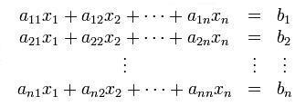
Solving n equations and n unknowns
Gaussian Elimination
Complexity: O(n³)
Successive Iteration
Complexity varies
Cholesky Decomposition
More efficient, still O(n³)
Levenson-Durbin
Complexity: O(n²)
Works for symmetric Toplitz matrices
Definitions for any matrix, A
Transpose (A^{T}): Replace a_{ij} by a_{ji} for all i and j
Symmetric: A^{T} = A
Toplitz: Diagonals to the right all have equal values

Slide 33
Covariance Example
Note: φ(j,k) = ∑_{n=start,start+N-1} y_{n-k}y_{n-j}
Signal: {…, 3, 2, -1, -3, -5, -2, 0, 1, 2, 4, 3, 1, 0, -1, -2, -4, -1, 0, 3, 1, 0, …}
Frame: {-5, -2, 0, 1, 2, 4, 3, 1}, Number of coefficients: 3
φ(1,1) = -3*-3 +-5*-5 + -2*-2 + 0*0 + 1*1 + 2*2 + 4*4 + 3*3 = 68
φ(2,1) = -1*-3 +-3*-5 + -5*-2 + -2*0 + 0*1 + 1*2 + 2*4 + 4*3 = 50
φ(3,1) = 2*-3 +-1*-5 + -3*-2 + -5*0 + -2*1 + 0*2 + 1*4 + 2*3 = 13
φ(1,2) = -3*-1 +-5*-3 + -2*-5 + 0*-2 + 1*0 + 2*1 + 4*2 + 3*4 = 50
φ(2,2) = -1*-1 +-3*-3 + -5*-5 + -2*-2 + 0*0 + 1*1 + 2*2 + 4*4 = 60
φ(3,2) = 2*-1 +-1*-3 + -3*-5 + -5*-2 + -2*0 + 0*1 + 1*2 + 2*4 = 36
φ(1,3) = -3*2 +-5*-1 + -2*-3 + 0*-5 + 1*-2 + 2*0 + 4*1 + 3*2 = 13
φ(2,3) = -1*2 +-3*-1 + -5*-3 + -2*-5 + 0*-2 + 1*0 + 2*1 + 4*2 = 36
φ(3,3) = 2*2 +-1*-1 + -3*-3 + -5*-5 + -2*-2 + 0*0 + 1*1 + 2*2 = 48
φ(1,0) = -3*-5 +-5*-2 + -2*0 + 0*1 + 1*2 + 2*4 + 4*3 + 3*1 = 50
φ(2,0) = -1*-5 +-3*-2 + -5*0 + -2*1 + 0*2 + 1*4 + 2*3 + 4*1 = 23
φ(3,0) = 2*-5 +-1*-2 + -3*0 + -5*1 + -2*2 + 0*4 + 1*3 + 2*1 = -12

Slide 34
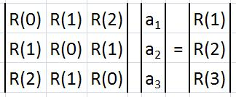
Auto Correlation Example
Note: φ(j,k)=∑_{n=0,N-1-(j-k)} y_{n}y_{n+(j-k)}=R(j-k)
Signal: {…, 3, 2, -1, -3, -5, -2, 0, 1, 2, 4, 3, 1, 0, -1, -2, -4, -1, 0, 3, 1, 0, …}
Frame: {-5, -2, 0, 1, 2, 4, 3, 1}, Number of coefficients: 3
R(0) = -5*-5 + -2*-2 + 0*0 + 1*1 + 2*2 + 4*4 + 3*3 + 1*1 = 60
R(1) = -5*-2 + -2*0 + 0*1 + 1*2 + 2*4 + 4*3 + 3*1 = 35
R(2) = -5*0 + -2*1 + 0*2 + 1*4 + 2*3 + 4*1 = 12
R(3) = -5*1 + -2*2 + 0*4 + 1*3 + 2*1 = -4
Assumption: all entries before and after the frame treated as zero

Slide 35
LPC Features as a front end
Assumptions
Future discrete signal samples are functions of the previous ones
The speech signal is purely linear (interactions with other signials add or subtract, but don’t multiply)
Coefficients: Generally eight to fourteen LPC coefficients are sufficient to represent a particular block of sound samples
Disadvantage: Linear prediction coefficients tend to be less stable other methods (ex: Cepstral analysis).
Enhancement: Perceptual Linear Prediction uses both frequency and time domain data. The result is comparable to Cepstral analysis. Rasta Linear Prediction also filters adjacent samples for an additional enhancement.

Slide 36
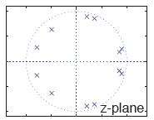
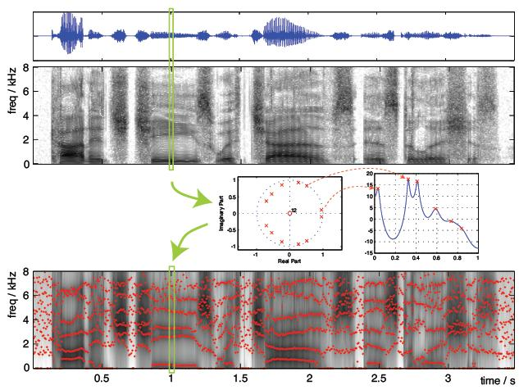
The LPC Spectrum
Perform a LPC analysis
Find the poles
Plot the spectrum around the z-Plane unit circle
What do we find concerning the LPC spectrum?
Adding poles better matches speech up to about 18 for a 16k sampling rate
The peaks tend to be overly sharp (“spiky”) because small radius changes greatly alters pole skirt widths in the z-plane

Slide 37
Filter Bank Front End
The bank consists of twenty to thirty overlapping band pass filters spread along the warped frequency axis
Represent spectrum with log-energy output from filter bank
Each frequency bank F handles frequencies from f-i to f+i or individual ranges of frequencies that models the rows of hair bands in the cochlea
The feature data is an array of energy values obtained from each filter
Result: Good idea, but it has not proven to be as effective as other methods

Slide 38
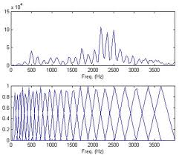
Warped band pass filter set
Original Spectrum
Mel frequency warping

Slide 39
Signal Filters
Purposes (General)
Examples
Separate Signals
Eliminate distortions
Remove unwanted data
Compress and decompress
Extract important features
Enhance desired components
Eliminate frequencies without speech information
Enhance poor quality recordings
Reduce background Noise
Adjust frequencies to mimic human perception
How? Execute a convolution algorithm

Slide 40
Convolution
public static double[] convolution(double[] x, double[] b, double[] a)
{ double[] y = new double[x.length + b.length - 1];
for (int i = 0; i < x.length; i ++)
{ for (int j = 0; j < b.length; j++)
{ if (i-j>=0) y[i] += b[j] * x[i - j]; }
if (a!=null)
{ for (int j = 1; j < a.length; j ++)
{ if (i-j>=0) y[i] -= a[j] * y[i - j]; }
}
}
return y;
}
The algorithm for creating Time Domain filters
Notes:
The symbol x commonly represents the raw time domain signal
The symbol Y represents the filterd signal
Capital X represents the frequency domain spectrum

Slide 41
Time Domain Filters
Finite Impulse Response
Filter only affects the data samples, hence the filter only effects a fixed number of data point
y[n] = b₀ s_{n}+ b₁ s_{n-1}+ …+ b_{M-1} s_{n-M+1}=∑_{k=0,M-1}b_{k} s_{n-k}
Infinite Impulse Response (also called recursive)
Filter affects the data samples and previous filtered output, hence the effect can be infinite
t[n] = ∑_{k=0,M-1}b_{k} s_{n-k} + ∑_{k=0,M-1} a_{k} t_{n-k}
If a signal was linear, so is the filtered signal
Why? We summed samples multiplied by constants, we didn’t multiply or raise samples to a power

Slide 42
Convolution Theorem
Multiplication in the time domain is equivalent to convolution in the frequency domain
Multiplication in the frequency domain equivalent to convolution in the time domain
Application: We can design a filter by creating its desired frequency response and then perform an inverse FFT to derive the filter kernel
Theoretically, we can create an ideal (“perfect”) low pass filter with this approach

Slide 43
Amplify
y[n] = k δ[n]
Top Figure (original signal)
Bottom Figure
The signal’s amplitude is multiplied by 1.6
Attenuation can occur by picking a magnitude that is less than one

Slide 44
Moving Average FIR Filter
Convolution using a simple filter kernel
int[] average(int x[])
{ int[] y[x.length];
for (int i=50; i<x.length-50; i++)
{ for (int j=-50; j<=50; j++) { y[i] += x[i + j]; }
y[i] /= 101;
} }
Formula:
Example Point:
Example Point (Centered):

Slide 45
IIR (Recursive) Moving Average
Two additions per point no matter the length of the filter
Example: y[50] = (x[47]+x[48]+x[49]+x[50]+x[51]+x[52]+x[53])/7 y[51] = (x[48]+x[49]+x[50]+x[51]+x[52]+x[53]+x[54])/7 = y[50] + (x[54] – x[47])/7
The general case y[i] = y[i-1] + (x[i+M/2] - x[i-(M+1)/2])/M
Note: Integers work best with this approach to avoid round off drift

Slide 46
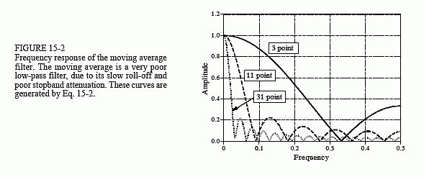
Moving Average Filter Characteristics
Longer kernel filters more noise
Long filters lose edge sharpness
Distorts the frequency domain
Very fast
Frequency response
sync function (sin(x)/x)
A degrading sine wave
Speech
Great for smoothing a pitch contour
Horrible for identifying formants

Slide 47
Time Domain Filtering
Band Pass
Filter frequencies below the minimum fundamental frequency (F0)
Filter frequencies above the speech range (≈4kHz)
Linear smoother and median of five filters
Used in combination to smooth the pitch contour
Derivative (slope) filter
Measure changes in a given feature from one frame to another
Tends to reduce the effects of noise in ASR
Noise Removal: Separate set of slides

Slide 48
Band Pass Filters
ACORNS uses both Butterworth and Window Sync filters
Butterworth
Advantages:
IIR filter, which is fast
minimal ripple
Disadvantage: slow transition
Window Sync
Advantage: quick transition
Disadvantages
FIR filter, which is slow
Ripples in the pass band
Many other filters with various advantages and disadvantages. Open source code for these exist.

Slide 49
Median of Five
private void medianOfFive(int feature)
{ double median, save, middle, out[] = new double[features.length];
for (int frame=2; frame<features.length - 2; frame++)
{ median = features[frame+2][feature];
save = features[frame+1][feature];
if (median > save) { median = features[frame+1][feature];
save = features[frame+2][feature]; }
if (features[frame-2][feature]<features[frame-1][feature])
{ if (features[frame-2][feature]>median) median= features[frame-2][feature];
if (features[frame-1][feature]<save) save = features[frame-1][feature];
} else
{ if (features[frame-1][feature]>median) median= features[frame-1][feature];
If (features[frame-2][feature]<save) save = features[frame-2][feature];
}
middle = features[frame][feature];
if ((save - middle) * (save-median) <= 0) median = save;
if ((middle - save) * (middle - median) <= 0) median = middle;
out[frame] = median;
}

Slide 50
Linear Smoother
private double[] linearSmoother (int frame, double[][] frames, int feature)
{ double[] out = new double[features.length];
for (int feature = 2; frame<frames[frame].length; frame++)
{
out[feature] = frames[frame][feature]/4
+ frames[frame-1][feature]/2
+ frames[frame-2][feature]/4;
} return out;
}

Slide 51
Derivative Filter
private void calculateDynamicFeatures(int featureOffset)
{ int start, end;
double numerator, denominator;
for (int frame=0; frame<features.length; frame++)
{ numerator = denominator = 0;
start = (frame<D) ? -frame: - D;
end = (frame>=features.length - D) ? features.length - frame - 1: +D;
for (int d= start; d<= end; d++)
{ numerator += d * features[frame + d][feature];
denominator += d * d;
}
if (denominator !=0) out[frame][feature] = numerator / denominator;
} }
Computes slope over 2D+1 frames

Slide 52
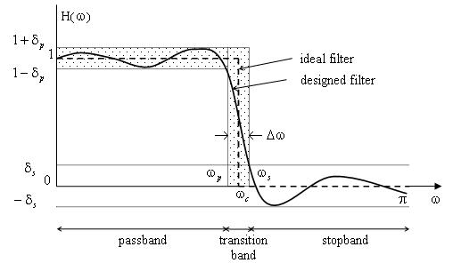
Filter Characteristics
Note: The ideal filter would require infinite computation

Slide 53
Filter Terminology
Rise time: Time for step response to go from 10% to 90%
Linear phase: Rising edges match falling edges
Overshoot: amount amplitude exceeds the desired value
Ripple: pass band oscillations
Ringing: stop band oscillations
Pass band: the allowed frequencies
Stop band: the blocked frequencies
Transition band: frequencies between pass or stop bands
Cutoff frequency: point between pass and transition bands
Roll off: transition sharpness between pass and stop bands
Stop band attenuation: reduced amplitude in the stop band

Slide 54
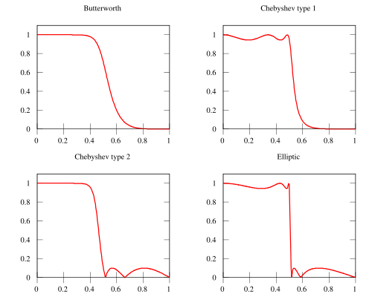
Filter Performance

