Slide 1
Spectral Analysis
Goal: Find useful frequency related features
Approaches
Apply a recursive band pass bank of filters
Apply linear predictive coding techniques based on perceptual models
Apply FFT techniques and then warp the results based on a MEL or Bark scale
Eliminate noise by removing non-voice frequencies
Apply auditory models
Deemphasize frequencies continuing for extended periods
Implement frequency masking algorithms
Determine pitch using frequency domain approaches

Slide 2
Complex Numbers
2+4j
Rectangular Notation
Complex numbers are written a + bi
a and b are real numbers
i (or j) satisfies the equation:
Characteristics of Complex Numbers
Extend the number system to two dimensions
i² = j² = -1
Note: Mathematicians use the symbol i; DSP normally uses j

Slide 3
Polar Notation
Distance and angle from the origin
Rectangular Form 4+i3
Convert to Polar Form (5,36.87)
M = sqrt(4²+3²) = 5
Ө = arctan(3/4)
Convert to Rectangular
A+ib = M(cos Ө + i * sinӨ)
Be Careful: At 90 and 270 degrees we have a divide by zero

Slide 4
Understanding Digital Signal Processing, Third Edition, Richard Lyons (0-13-261480-4) © Pearson Education, 2011.
Multiplications of complex numbers are rotations

Slide 5
Operations on Complex Numbers
Definition: Conjugate of a + bj is a - bj
Addition: (a + bj) + (c+dj) = (a+c) + (b+d)j
Subtraction: (a+bj) – (c+dj) = (a-c) + (b-d)j
Multiplication: (a+bj) * (c+dj) = (ac-bd) + (bc+ad)j
Division: Change the problem to a multiplication
Trick: Multiply the numerator and denominator by the conjugate of the denominator
Result: Complex parts of denominator cancel, which effectively changes the division to a multiplication (a+bj) / (c+dj) = (a+bj) * (c-dj) / {(c+dj)*(c-di) } = ((ac+bd) + (bc-ad)i)/(c² + d²)

Slide 6
Understanding Digital Signal Processing, Third Edition, Richard Lyons (0-13-261480-4) © Pearson Education, 2011.

Slide 7
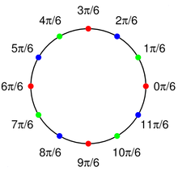
N Roots of Unity
for (double angle=0;
angle<Math.PI * 2;
angle += 2*Math.PI/N)
{
System.out.println (cos(angle) + "j" + sin(angle);
}
N = 12
Radius = 1
Multiplying rotates a unit circle point by the angle of the other
For N roots, other than unity, simply multiply by the magnitude

Slide 8
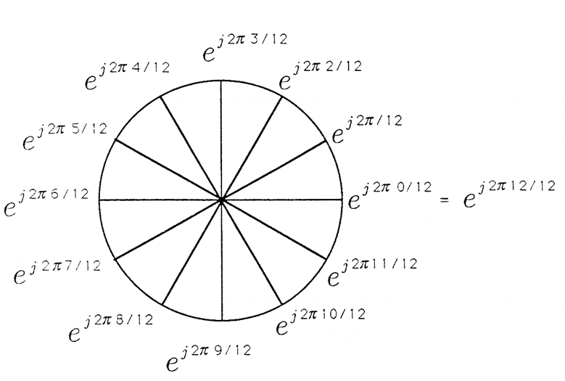
Euler’s Formula
The properties of exponentials enable
Fast multiplies/divides:
M₁ e^{Ө1j} * M₂ e^{Ө2j} = M₁ * M₂ e^{j(Ө1 + Ө2)} and M₁ e^{Ө1j} / M₂ e^{Ө2j} = M₁ / M₂ e^{j(Ө1 - Ө2)}
Reduced calculations: e^{128/256} = e^{64/128} = e^{32/64} = e^{16/32} = e^{8/16} = e^{4/8} = e^{2/4} = e^{1/2}
Consise polar notation (represents magnitude and phase): Me^{jϕ}
Elegant FFT algorithm: transfer from time to frequency domain
Me^{jӨ} = M(CosӨ + j SinӨ)

Slide 9
Trigonometric Identities
cos(x)=cos(-x) and sin(x)=-sin(-x)
cos(x) = (e^{ix} + e^{-ix})/2
sin(x) = (e^{ix} – e^{-ix})/2i
sin²(x)+ cos²(x) = 1
sin(x+y) = sin(x)cos(y) + cos(x)sin(y)
cos(x+y) = cos(x)cos(y) - sin(x)sin(y)

Slide 10
DFT Correlation Algorithm
public double[] DFT( double[] time)
{ int N = time.length;
double fourier[] = new double[2*N], real, imag;
for (int k=0; k<N; k++)
{ for (int i=0; i<N; i++)
{ real = Math.cos(2*Math.PI*k*i/N);
imag = -Math.sin(2*Math.PI*k*i/N);
fourier[2*k] += time[i]*real;
fourier[2*k+1]+= time[i]*imag;
} }
return fourier;
}
Complexity: O(N²) because of the double loop of N each
Example: For 512 samples, loops 262144 times
Evaluation: Too slow, but FFT is O(N lg N)
Note: even indices = real part, odd indices = imaginary part

Slide 11
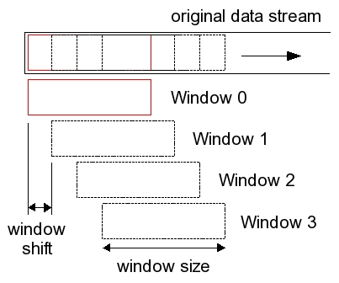
Relation to Speech
For analysis we breakup signal into overlapping windows
Why?
Speech is quasi-periodic, not periodic
Vocal musculature is always changing
Within a small window of time, we assume constancy, and process as if the signal were periodic
Typical Characteristics
10-30 ms length
1/3 to 1/2 overlap

Slide 12
DFT Issues
Implementation difficulties
Impact: Algorithm runs too slow, especially for real time processing
Solution: FFT algorithm
Spectral Leakage: Occurs when a signal has frequencies that fall between those of the DFT basis functions
Result: Magnitude leaks over the entire spectrum
Solutions: Windowing and DFT padding
Inadequate frequency resolution
Impact: DFT magnitudes represent wide ranges of frequencies
Solution: DFT zero padding
Signal rough edges:
Impact: Inaccuracies because windows don’t have smooth transistions
Solution: Windowing

Slide 13
DFT Zero Padding
Each frequency domain bin represents a range of frequencies
Assume sampling rate fs = 16000, N = 512
Frequency domain 3, contains magnitudes for frequencies between 16000/512*3 (93.75) to 16000/512*4 (125)
Each frequency bin models a range of 31.25 frequencies
Padding the time domain frame with zeroes adds high frequency components, but does not negatively impact the result, or impact the lower frequencies of the spectrum

Slide 14
Fourier Analysis
Real-time DSP Algorithms must be as efficient as possible
The Naïve DFT requires a double loop
Outer loop is T long (length of the time domain frame)
Inner loop is N long (number of FFT frequency bins)
Total calculations: O(N*T), or O(N²) when N = T
Fast Fourier Transform (FFT)
N must be an even power of 2, if not, pad with zeros
Total calculations O(N lgN) calculations
Compare efficiencies
N | N² | lg N | N lg N | Improvement
128 | 16,384 | 7 | 896 | 18.2857
1,024 | 1,048,576 | 10 | 10,240 | 102.4000
8,192 | 67,108,864 | 13 | 106,496 | 630.1538

Slide 15
The Fast Fourier Transform
The FFT is an efficient divide and conquer algorithm
For polynomials, If n is even, we can divide
into two smaller polynomials
and we can write the equation as follows
This suggests recursion of lg(n) steps. The above equation is the recursive relationship between levels
P_{even}(x) = a₀ + a₂x² + a₄x⁴ + … + a_{n-2} x^{n-2}
P_{odd}(x) = a₁ + a₃ x² + … + a_{n-1} x^{n-1}
P(x) = p_{even}(x) + x * p_{odd}(x)

Slide 16
Theory for Optimization
Base Case: x[0]
Recursive Relationship
F_{k} = ∑_{t=0→N-1} x[t] e^{-j2πkt/N}
= ∑_{t=0→N/2-1} x[2t] e^{-j2πk(2t)/N}
⁺ ∑_{t=0→N/2-1} x[2t+1] e^{-j2πk(2t+1)/N}
= ∑_{t=0→N/2-1} x[2t] e^{-j2πkt/(N/2)}
⁺ ∑_{t=0→N/2-1} x[2t+1] e^{-j2πk(2t+1)/N}
= ∑_{t=0→N/2-1} x[2t] e^{-j2πkt/(N/2)}
⁺ e^{-j2πk/N}∑_{t=0→N/2-1} x[2t+1] e^{-j2πkt/(N/2)}
= F_{k}^{even} + e^{-j2πk/N *} F_{k}^{odd}
(2t)/N = t/(N/2)

Slide 17
The FFT Algorithm
The recursive step has O(N) computations
The recursion requires O(lg(N)) levels
Total calculations are O(N lg(N))

Slide 18
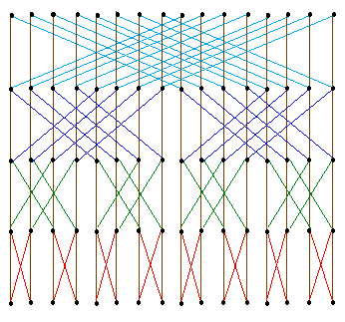
FFT Recursive Efficiency
Figure to the right
FFT of 16 points
O(N) work at each level
lg N + 1 = 5 levels
Total calculations: O(N lg(N)

Slide 19
The FFT Algorithm Overview
Initial Recursive Call (FFT(time) time contains signal amplitudes, and is a power of 2 length (N)
Base Case: n=1, then return the time array
Divide Step separate time into even (time_{even}) and odd (time_{odd}) sub-arrays
Recursive Step: y_{even} = FFT(time_{even}), y_{odd}= FFT(time_{odd})
Combine Step For loop of complex number multiplications

Slide 20
Simple Recursive Solution
public static Complex[] FFT(Complex[] time)
{ int N = time.length;
Complex[] fourier = new Complex[N];
if (N==1) { fourier[0] = time[0]; return fourier; }
Complex[] even = new Complex[N/2], odd = new Complex[N/2];
for (int m=0; m<N/2; m++)
{ even[m] = time[2*m]; odd[m] = time[2*m+1]; }
Complex[] q = FFT(even), r = FFT(odd);
for (int k=0; k<N/2; k++)
{ double exp = -2*k* Math.PI /N;
Complex wk = new Complex(Math.cos(exp), Math.sin(exp));
fourier[k] = q[k].plus(wk.times(r[k])); fourier[k+N/2] = q[k].minus(wk.times(r[k]));
}
return fourier; }
Note: e^{-2kπ/N} = -e^{-2kπ/N+N/2}

Slide 21
Inefficiencies
Computations still are an order of magnitude slower than necessary
Repetitive calculations of sines and cosines are extremely slow
Recursive activation record overhead is huge
Declaring and copying arrays at every step slows things down at least by half
N>>1 is ten times faster than N/2
The Complex class methods cause machine code jumps that put pressure on the hardware cache

Slide 22
Eliminating the Recursion
Butterfly algorithm
000
001
010
011
100
101
110
111
000
010
100
110
001
011
101
111
000
100
010
110
001
101
011
111
The numbers in the rectangles are the array indices
Notice how the indices change during the recursion
Can you see a pattern ?

Slide 23
Bit flipping implementation
Determine if a number is an even power of two: n & (n-1)
Determine the upper most bit number, B int B=1, x = n-1; while (x&(x-1)) B++;
Result = 0 FOR each bit b from 0 to B
IF bit set, shift B – b and OR into result

Slide 24
Butterfly Code
Flip bits from left to right
int j = N>>1, k;
for (int i=1;i<N-1;i++)
{ if (i < j)
{ swap (x[i],x[j]);}
k = N>>1;
while (k>=2 & j>=k)
{ j -= k;
k >>= 1;
}
j += k;
}
Most Significant Bit SwapBit ( x, x + lgN)
Second most significant bit SwapBit(x, x + lg(N/2)
Third most significant bit SwapBit(x, x + lg(N/4)
kth most significant bit SwapBit(x, x + lg(N/2^{k}))

Slide 25
Sin and Cosine Table Look Up
Compute the values ahead of time and save repetitive calculations
e^{i2πk/N} = cos(2πk/N) + i sin(2πk/N)
We can store in an array (sinX[]) sin(2π0/N), sin(2π1/N), sin(2π2/N) sin(2π3/N), … sin(2π(N-1)/N)
cos(2πk/N) = cosX[(k+(N>>2))%N]

Slide 26
Understanding Digital Signal Processing, Third Edition, Richard Lyons (0-13-261480-4) © Pearson Education, 2011.
W^{k}_{N}= e^{2πk/N}
This relationship allows table lookups for precomputed sines and cosines

Slide 27
Optimized FFT
// Perform the fft calculations.
for (int stage=1; stage<=M; stage++) // M = lg N
{
// Remember that complex numbers require pairs of doubles
fftSubGroupGap = 2<<stage; // 4, 8, 16, ... – subgroup distance
gap = fftSubGroupGap>>1; // 2, 4, 8, ... – odd/even distance
kInc = N>>1; // Number of 2PIki/N steps for odd/even entries.
// Outer loop: each sub-fft group; inner loop: combine group elements
for (int even=0; even<complex.length; even+=fftSubGroupGap)
{ k = 0; // Index into the trigonometric lookup table.
for (int element=even; element<(even+gap); element+=2)
{ // ***** See Next Slide ***** k += kInc; // position for next look up.
} }
kInc >>= 1;
}

Slide 28
Multiplication Portion
// Look up e^2PIki/N avoiding trig calculations here.
realW = sines[(k+(N>>2))%N]; // cos(2PIk/N);
imagW = -sines[k%N]; // -sin(2PIk/N);
// Complex multiplication of the odd entry of the subgroup
// with (e^2PIi/N)^k = (cos(2PI/N) - i * sin(2*PI/N)^k
j = (element + gap);
tempReal = realW * complex[j] - imagW * complex[j+1];
tempImag = realW * complex[j+1] + imagW * complex[j];
// Adjust the odd entry (subtract: the fft is periodic).
complex[j] = complex[element] - tempReal;
complex[j+1] = complex[element+1] -tempImag;
//Adjust the even entry.
complex[element] += tempReal;
complex[element+1] += tempImag;

Slide 29
Cepstrum
History (Bogert et. Al. 1963)
Definition Fourier Transform (or Discrete Cosine Transform) of the log of the magnitude (absolute value) of a Fourier Transform
Concept Treats the frequency as a “time domain” signal and computes the frequency spectrum of the spectrum
Pitch Algorithm
Vocal track excitation (E) and harmonics (H) are multiplicative, not additive. F1, F2, … are integer multiples of F0
The log converts the multiplicity to a sum
log(|X(ω)|) = Log(|E(ω)||H(ω)|) = log(|E(ω)|)+log(|H(ω)|)
The pitch shows up as a spike in the lower part of the Cepstrum

Slide 30
Terminology
Cepstrum Terminology | Frequency Terminology
Cepstrum | Spectrum
Quefrency | Frequency
Rahmonics | Harmonics
Gamnitude | Magnitude
Sphe | Phase
Lifter | Filter
Short-pass Lifter | Low-pass Filter
Long-pass Lifter | High-pass-Filter
Notice the flipping of the letters – example Ceps is Spec backwards

Slide 31
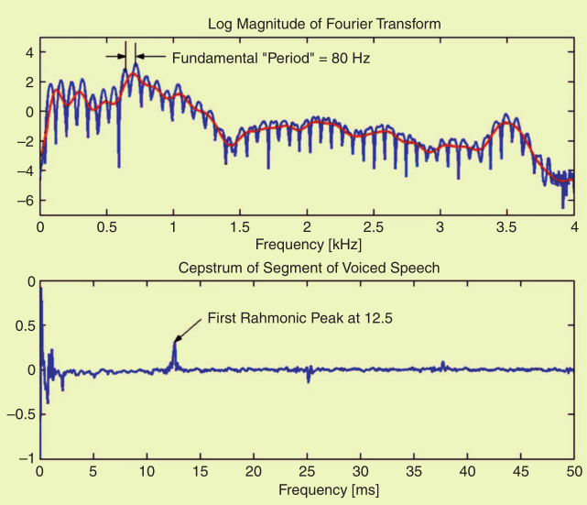
Cepstrum and Pitch

Slide 32
Cepstrums for Formants
Time
Speech Signal
Frequency
After FFT
Log Frequency
After log(FFT)
Cepstrums of Excitation
Time
After inverse FFT of log
Answer: It makes it easier to identify the formants

Slide 33
Harmonic Product Spectrum
Concept
Speech consists of a series of spectrum peaks, at the fundamental frequency (F0), with the harmonics being multiples of this value
If we compress the spectrum a number of times (down sampling), and compare these with the original spectrum, the harmonic peaks align
When the various down sampled spectrums are multiplied together, a clear peak will occur at the fundamental frequency
Advantages: Computationally inexpensive and reasonably resistant to additive and multiplicative noise
Disadvantage: Resolution is only as good as the FFT length. A longer FFT length will slow down the algorithm

Slide 34
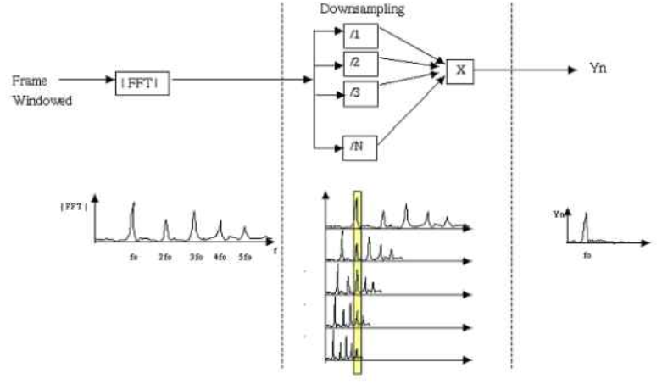
Harmonic Product Spectrum
Notice the alignment of the down sampled spectrums

Slide 35
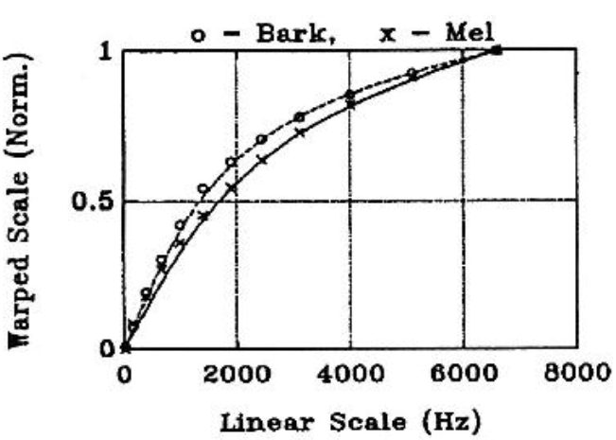
Frequency Warping
Audio signals cause cochlear fluid pressure variations that excite the basilar membrane. Therefore, the ear perceives sound non-linearly
Mel and Bark scale are formulas derived from many experiments that attempt to mimic human perception

Slide 36
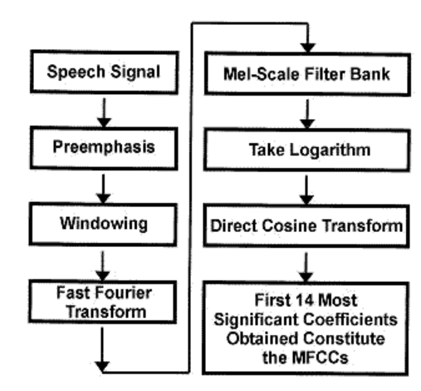
Mel Frequency Cepstral Coefficients
Preemphasis deemphasizes the low frequencies (similar to the effect of the basilar membrane)
Windowing divides the signal into 20-30 ms frames with ≈50% overlap applying Hamming windows to each
FFT of length 256-512 is performed on each windowed audio frame
Mel-Scale Filtering results in 40 filter values per frame
Discrete Cosine Transform (DCT) further reduces the coefficients to 14 (or some other reasonable number)
The resulting coefficients are statistically trained for ASR
Note: DCT used because it is faster than FFT and we ignore the phase

Slide 37
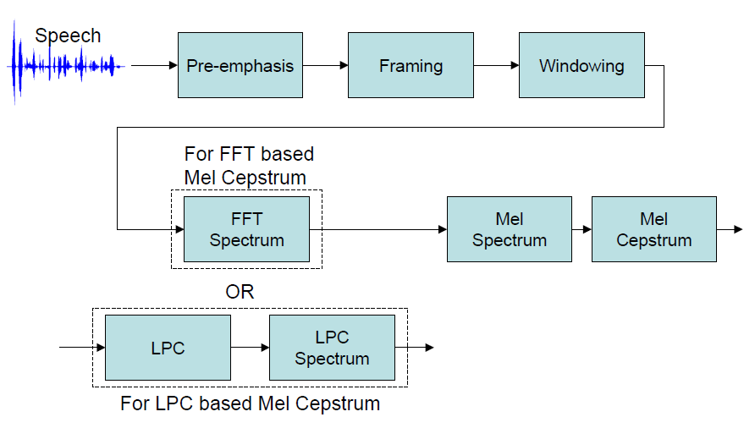
Front End Cepstrum Procedure

Slide 38
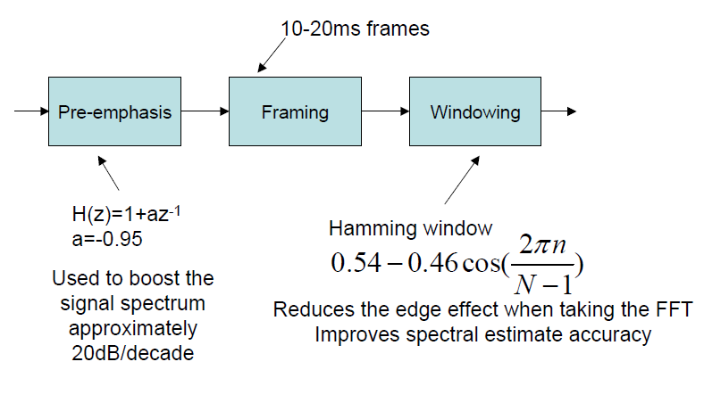
Preemphasis/Framing/Windowing

Slide 39
Discrete Cosine Transform
Notes
N is the desired number of DCT coefficients
k is the “quefrency bin” to compute
Implemented with a double for loop, but N is usually small

Slide 40
MFCC Enhancements
Resulting feature array size is 3 times the number of Cepstral coefficients
Derivative and double derivative coefficients model changes in the speech between frames
Mean, Variance, and Skew normalize results for improved ASR performance

Slide 41
Statistics: Moments
First moment - Mean or average value: μ = ∑_{i=1,N} s_{i}
Second moment - Variance or spread: σ² = ¹/_{N}∑_{i=1,N}(s_{i -} μ)²
Standard deviation – square root of variance: σ
3rd standardized moment- Skewness: γ₁ = ¹/_{N}∑_{i=1,N}(s_{i}-μ)³/σ³
Negative tail: skew to the left
Positive tail: skew to the right
4th standardized moment – Kurtosis: γ₂ = ¹/_{N}∑_{i=1,N}(s_{i}-μ)⁴/σ⁴
Positive: relatively peaked
Negative: relatively flat

Slide 42
Statistical Calculations (Excel Formulas)
for (int frame=0; frame< N; frame++) // Total a given feature over all frames
{ totals[MEAN][feature] += features[frame][offsets[feature]]; }
totals[MEAN][feature]/= N; } // Compute mean
double delta, stdev;
for (int frame=0; frame < N; frame++)
{ delta = (features[frame][offsets[feature]] - totals[MEAN][feature]); totals[VARIANCE][feature] += delta * delta;
totals[SKEW][feature] += Math.pow(delta, 3);
totals[KIRTOSIS][feature] += Math.pow(delta, 4);
}
totals[VARIANCE][feature] = totals[VARIANCE][feature] /= N - 1;
totals[STD][feature] = stdev = Math.sqrt(totals[VARIANCE][feature]);
totals[SKEW][feature] = 1.0*N/((N-1)*(N-2))
* totals[SKEW][feature]/Math.pow(stdev,3);
totals[KIRTOSIS][feature] = 1.0*N*(N+1) /((N-1)*(N-2)*(N-3)) * totals[KIRTOSIS][feature] / Math.pow(stdev,4);
totals[KIRTOSIS][feature] -= 3.0 * (N-1)*(N-1) / ((N-2)*(N-3));

Slide 43
Mean Normalization
public static double[][] meanNormalize ( double[][] features, int feature )
{ double mean = 0;
for (int row: features)=0; row<features.length; row++)
{ mean += features[row][feature]; }
mean = mean / features.length;
for (int row=0; row<features.length; row++)
{ features[row][feature] -= mean; }
return features;
} // end of meanNormalize
Normalize to the mean will be zero

Slide 44
Variance Normalization
public static double[][] varNormalize(double[][] features, int feature)
{ double variance = 0;
for (int row=0; row<features.length; row++)
{ variance += features[row][feature] * features[row][feature]; }
variance /= (features.length - 1);
for (int row=0; row<features.length; row++)
{ if (variance!=0) features[row][feature] /= Math.sqrt(variance); }
return features;
} // End of varianceNormalize()
Scale feature to [-1,1] - divide the feature's by the standard deviation

Slide 45
Skew Normalization
public static double[][] skewNormalize(double[][] features, int feature)
{ double fN=0, fPlus1=0, fMinus1=0, value, coefficient;
for (int row=0; row<features.length; row++)
{ fN += Math.pow(features[row][feature], 3);
fPlus1 += Math.pow(features[row][feature], 4);
fMinus1 += Math.pow(features[row][feature], 2);
}
if (momentNPlus1 != momentNMinus1) coefficient = -fN/(3*(fPlus1-fMinus1));
for (int row=0; row<features.length; row++)
{ value = features[row][column];
features[row][column] = coefficient * value * value + value - coefficient;
}
return features;
} // End of skewNormalization()
Minimizes the skew for the distribution to be more normal

Slide 46
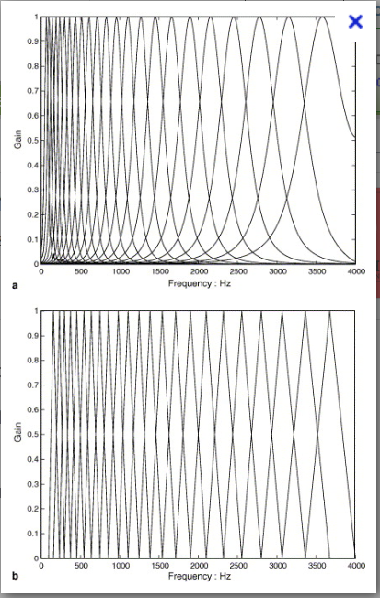
Mel Filter Bank
Gaussian filters (top), Triangular filters (bottom)
Frequencies in overlapped areas contribute to two filters
The lower frequencies are spaced more closely together to model human perception
The end of a filter is the mid point of the next
Warping formula: mel = 2595 log(1 + 5/700)

Slide 47
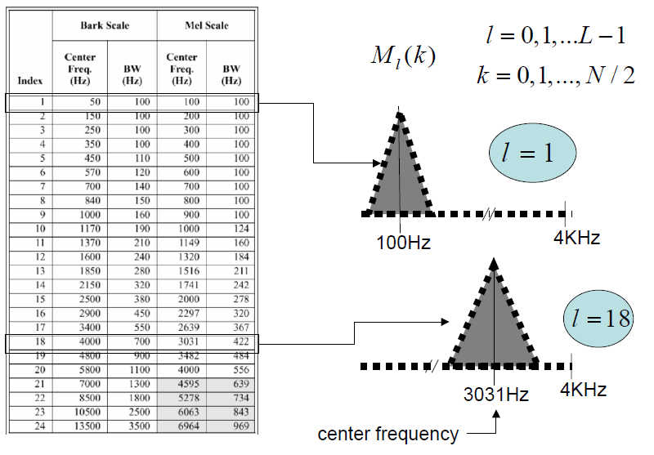
Mel Frequency Table

Slide 48
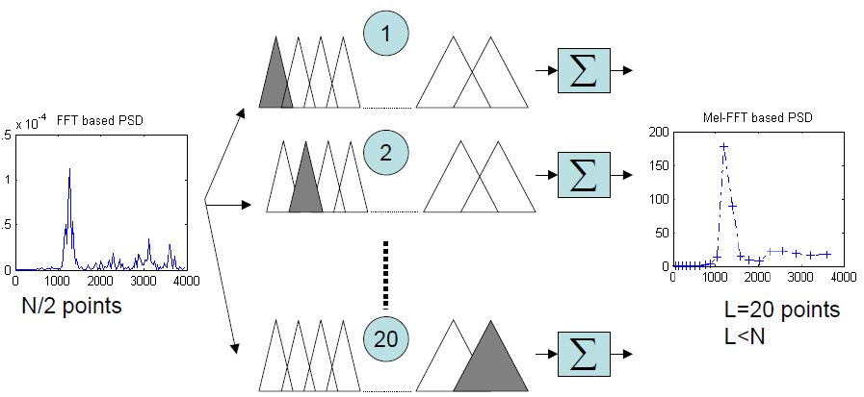
Mel Filter Bank
Multiply the power spectrum with each of the triangular Mel weighting filters and add the result -> Perform a weighted averaging procedure around the Mel frequency

Slide 49
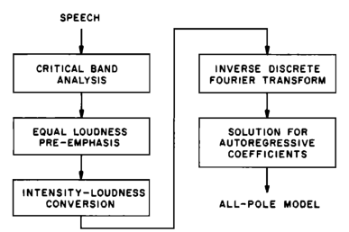
Perceptual Linear Prediction
Speech
DFT of Hamming Windowed Frame
Cepstral Recursion

Slide 50
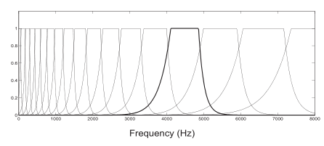
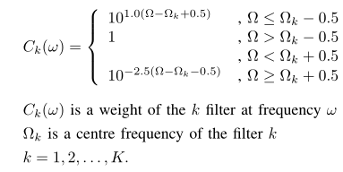
Critical Band Analysis
The bark filter bank is a crude approximation of what is known about the shape of auditory filters.
It exploits Zwicker's (1970) proposal that the shape of auditory filters is nearly constant on the Bark scale.
The filter skirts are truncated at +- 40 dB
There typically are about 20-25 filters in the bank
Critical Band Formulas

Slide 51
Equal Loudness Pre-emphasis
Note: Done in frequency domain, not in the time domain
private double equalLoudness(double freq)
{ double w = freq * 2 * Math.PI;
double wSquared = w * w;
double wFourth = Math.pow(w, 4);
double numerator = (wSquared + 56.8e6) * wFourth;
double denom = Math.pow((wSquared+6.3e6), 2)*(wSquared+0.38e9);
return numerator / denom;
}
Formula (w^2+56.8e6)*w^4/{ (w^2+6.3e6)^2 * (w^2+0.38e9) * (w^6+9.58e26) }
Where w = 2 * PI * frequency

Slide 52
Intensity Loudness Conversion
Note: The intensity loudness power law to bark filter outputs
which approximates simulates the non-linear relationship between sound intensity and perceived loudness.
private double[] powerLaw(double[] spectrum)
{
for (int i = 0; i < spectrum.length; i++)
{ spectrum[i] = Math.pow(spectrum[i], 1.0 / 3.0);
}
return spectrum;
}

Slide 53
Cepstral Recursion
public static double[] lpcToCepstral( int P, int C, double[] lpc, double gain)
{ double[] cepstral = new double[C];
cepstral[0] = (gain<EPSELON) ? EPSELON : Math.log(gain);
for (int m=1; m<=P; m++)
{ if (m>=cepstral.length) break;
cepstral[m] = lpc[m-1];
for (int k=1; k<m; k++) { cepstral[m] += k * cepstral[k] * lpc[m-k-1]; }
cepstral[m] /= m;
}
for (int m=P+1; m<C; m++)
{ cepstral[m] = 0;
for (int k=m-P; k<m; k++) { cepstral[m] += k * cepstral[k] * lpc[m-k-1]; }
cepstral[m] /= m;
}
return cepstral;
}

Slide 54
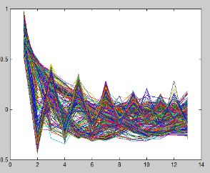
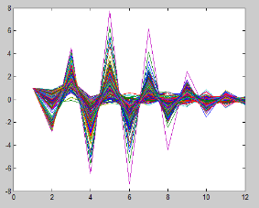
Comparison of MFCC and LPC features
MFCC Features
LPC features
Two speakers, five utterances each; word “ananas”

Slide 55
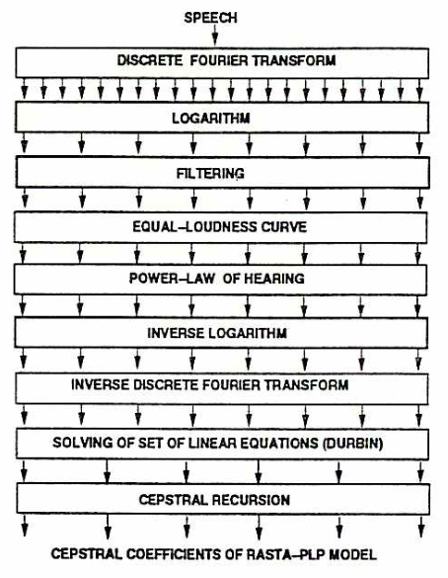
Rasta (Relative Spectra) Perceptual Linear Prediction Front End

Slide 56
Additional Rasta Spectrum Filtering
Concept: A band pass filters is applied to frequencies of adjacent frames. This eliminates slow changing, and fast changing spectral changes between frames. The goal is to improve noise robustness of PLP
The formula below was suggested by Hermansky (1991). Other formulas have subsequently been tried with varying success

Slide 57
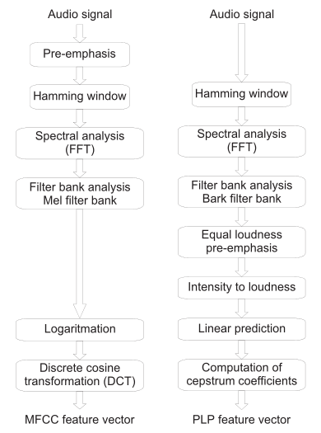
Comparison of Front End Approaches
Conclusion: PLP and MFCC, and RASTA provide viable features for ASR front ends. ACORNS contains code to implement each of these algorithms. To date, there is no clear cut winner.

