Slide 1
Background Noise
Definition: an unwanted sound or an unwanted perturbation to a wanted signal
Examples:
Clicks from microphone synchronization
Ambient noise level: background noise
Roadway noise
Machinery
Additional speakers
Background activities: TV, Radio, dog barks, etc.
Classifications
Stationary: doesn’t change with time (i.e. fan)
Non-stationary: changes with time (i.e. door closing, TV)

Slide 2
Noise Spectrums
White Noise: constant over range of f
Pink Noise: Decreases by 3db per octave; perceived equal across f but actually proportional to 1/f
Brown(ian): Decreases proportional to 1/f² per octave
Red: Decreases with f (either pink or brown)
Blue: increases proportional to f
Violet: increases proportional to f²
Gray: proportional to a psycho-acoustical curve
Orange: bands of 0 around musical notes
Green: noise of the world; pink, with a bump near 500 HZ
Black: 0 everywhere except 1/f^{β} where β>2 in spikes
Colored: Any noise that is not white
Audio samples: http://en.wikipedia.org/wiki/Colors_of_noise
Signal Processing Information Base: http://spib.rice.edu/spib.html

Slide 3
Applications
ASR:
Prevent significant degradation in noisy environments
Goal: Minimize recognition degradation with noise present
Sound Editing and Archival:
Improve intelligibility of audio recordings
Goals: Eliminate noise that is perceptible; recover audio from old wax recordings
Mobile Telephony:
Transmission of audio in high noise environments
Goal: Reduce transmission requirements
Comparing audio signals
A variety of digital signal processing applications
Goal: Normalize audio signals for ease of comparison

Slide 4
Signal to Noise Ratio (SNR)
Definition: Power ratio between a signal and noise that interferes.
Standard Equation in decibels: SNR_{db} = 10 log(A _{Signal}/A_{Noise})² N= 20 log(A_{signal}/A_{noise})
For digitized speech
SNR_{f} = P(signal)/P(noise) = 10 log(∑_{n=0,N-1}s_{f}(n)²/n_{f}(x)²) where s_{f} is an array holding samples from frame, f; and n_{f} is an array of noise samples.
Note: if s_{f}(n) = n_{f}(x), SNR_{f} = 0

Slide 5
Stationary Noise Suppression
Requirements
low residual noise
low signal distortion
low complexity (efficient calculation)
Problems
Tradeoff between removing noise and distorting the signal
More noise removal normally increases the signal distortion
Popular approaches
Time domain: Moving average filter (distorts frequency domain)
Frequency domain: Spectral Subtraction
Time domain: Weiner filter (autoregressive)

Slide 6
Auto regression
Definition: An autoregressive process is one where a value can be determined by a linear combination of previous values
Formula: X_{t} = c + ∑_{0,P-1}a_{i} X_{t-i} + n_{t}
This is linear prediction; noise is the residue
Convolute the signal with the linear coefficient coefficients to create a new signal
Disadvantage: The fricative sounds, especially those that are unvoiced, are distorted by the process

Slide 7
Spectral Subtraction
Noisy signal: y_{t} = s_{t} + n_{t} where s_{t} is the clean signal and n_{t} is additive noise
Therefore: s_{t} = y_{t} – n_{t} and estimated s’_{t} = y_{t} – n’_{t}
Algorithm (Estimate Noise from segments without speech)
Compute FFT to compute X(f)
IF not speech THEN Adaptively adjust the previous noise spectrum estimate N(f)
ELSE FOR EACH frequency bin: Y’(f) = (|Y(f)|ª – |N(f)|ª)^{1/a}
Perform an inverse FFT to produce a filtered signal
Note: (|Y(f)|ª – |N’(f)|ª)^{1/a} is a generalization of (|Y(f)|² – |N’(f)|²)^{½}
S. F. Boll, “Suppression of acoustic noise in speech using spectral subtraction," IEEE Trans. Acoustics, Speech, Signal Processing, vol. ASSP-27, Apr. 1979.

Slide 8
Spectral Subtraction Block Diagram
Note: Gain refers to the factor to apply to the frequency bins

Slide 9
Assumptions
Noise is relatively stationary
within each segment of speech
The estimate in non-speech segments is a valid predictor
The phase differences between the noise signal and the speech signal can be ignored
The noise is a linear signal
There is no correlation between the noise and speech signals
There is no correlation between noise in the current sample with noise in previous samples

Slide 10
Implementation Issues
Question: How do we estimate the noise? Answer: Use the frequency distribution during times when no voice is present
Question: How do we know when voice is present? Answer: Use Voice Activity Detection algorithms (VAD)
Question: Even if we know the noise amplitudes, what about phase differences between the clean and noisy signals? Answer: Since human hearing largely ignores phase differences, assume the phase of the noisy signal.
Question: Is the noise independent of the signal? Answer: We assume that it is.
Question: Are noise distributions really stationary? Answer: We assume yes.

Slide 11
Phase Distortions
Problem: We don’t know how much of the phase in an FFT is from noise and from speech
Assumption: The algorithm assumes the phase of both are the same (that of the noisy signal)
Result: When SNR approaches 0db the noise filtered audio has an hoarse sounding voice
Why: The phase assumption means that the expected noise magnitude is incorrectly calculated
Conclusion: There is a limit to spectral subtraction utility when SNR is close to zero

Slide 12
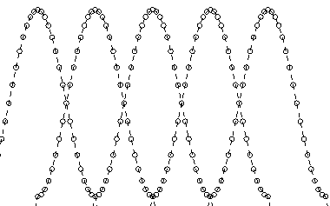
Echoes
The signal is typically framed with a 50% overlap
Rectangular windows lead to significant echoes in the filtered noise reduced signal
Solution: Overlapping windows by 50% using Bartlet (triangles), Hanning, Hamming, or Blackman windows reduces this effect
Algorithm
Extract frame of a signal and apply window
Perform FFT, spectral subtraction, and inverse FFT
Add inverse FFT time domain to the reconstructed signal
Note: Hanning tends to work best for this application because with 50% overlap, Hanning windows do not alter the power of the original signal power on reconstruction

Slide 13
Musical noise
Definition: Random isolated tone bursts across the frequency.
Why? Subtraction could cause some bins to have negative power
Solution: Most implementations set frequency bin magnitudes to zero if noise reduction would cause them to become negative
Green dashes: noisy signal, Solid line: noise estimate
Black dots: projected clean signal

Slide 14
Evaluation
Advantages: Easy to understand and implement
Disadvantages
The noise estimate is not exact
When too high, speech portions will be lost
When too low, some noise remains
When a noise frequency exceeds the noisy sound frequency, a negative frequency results
Incorrect assumptions: Negligible with large SNR values; significant impact with small SNR values.

Slide 15
Ad hoc Enhancements
Eliminate negative frequencies:
S’(f) = Y(f)( max{1 – (|N’(f)|/Y(f))ª )^{1/a}, t}
Result: minimize the source of musical noise
Reduce the noise estimate
S’(f) = Y(f)( max{1 – b(|N’(f)|/Y(f))ª )^{1/a}, t}
Apply different constants for a, b, t in different frequency bands
Turn to psycho-acoustical methods: Don’t attempt to adjust masked frequencies
Maximum likeliood: S’(f) = Y(f)( max{½–½(|N’(f)|/Y(f))ª )^{1/a},t}
Smooth spectral subtractions over adjacent time periods: G_{S}(p) = λ_{F}G_{S}(p-1)+(1-λ_{F})G(p)
Exponentially average noise estimate over frames
|W (m,p)|² = λ_{N}|W(m,p-1)|² + (1-λ_{N})|X(m,p)², m = 0,…,M-

Slide 16
Acoustic Noise Suppression
Take advantage of the properties of human hearing related to masking
Preserve only the relevant portions of the speech signal
Don’t attempt to remove all noise, only that which is audible
Utilize: Mel or Bark Scales
Perhaps utilize overlapping filter banks in the time domain

Slide 17
Acoustical Effects
Characteristic Frequency (CF): The frequency that causes maximum response at a point of the Basilar Membrane
Saturation: Neuron exhibit a maximum response for 20 ms and then decrease to a steady state, recovering a short time after the stimulus is removed
Masking effects: can be simultaneous or temporal
Simultaneous: one signal drowns out another
Temporal: One signal masks the ones that follow
Forward: still audible after masker removed (5ms–150ms)
Back: weak signal masked from a strong one following (5ms)

Slide 18
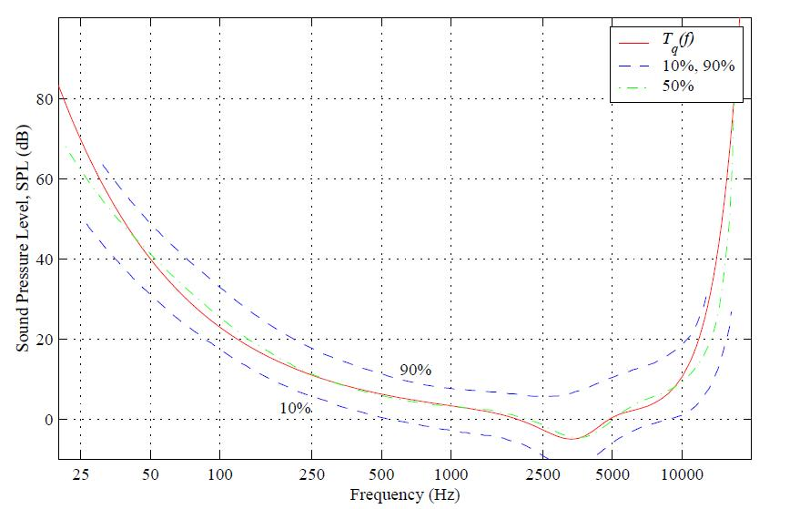
Threshold of Hearing
The limit of the internal noise of the auditory system
Tq(f) = 3.64(f/1000)^{-0.8} – 6.5e^{-0.6(f/1000-3:3)^2} + 10⁻³(f/1000)⁴ (dB SPL)

Slide 19
Masking

Slide 20
Non Stationary Noise
Example: A door slamming, a clap
Characterized by sudden rapid changes in: Time Domain signal, Energy, or in the Frequency domain
Large amplitudes outside the normal frequency range
Short duration in time
Possible solutions: compare to energy, correlation, frequency of previous frames and delete frames considered to contain non-stationary noise
Example: cocktail party (background voices)
What would likely happen to happen in the frequency domain? How about in the time domain? How to minimize the impact? Any Ideas?

Slide 21
Voice Activity Detection (VAD)
Problem: Determine if voice is present in an audio signal
Issues:
Without VAD, ASR accuracy degrades by 70% in noisy environments. VAD has more impact on robust ASR than any other single component
Using only energy as a feature, loud noise looks like speech and unvoiced speech as noise
Applications: Speech Recognition, transmission, and enhancement
Goal: extract features from a signal that emphasize differences between speech and background noise
Evaluation Standard: Without an objective standard, researchers cannot scientifically evaluate various algorithms
H.G. Hirsch, D. Pearce, “The Aurora experimental framework for the performance evaluation of speech recognition systems under noisy conditions,” Proc. ISCA ITRW ASR2000, vol. ASSP-32, pp. 181-188, Sep. 2000

Slide 22
Samples of VAD approaches
Noise
Level estimated during periods of low energy
Adaptive estimate: The noise floor estimate lowers quickly and raises slowly when encountering non-speech frames
Energy: Speech energy significantly exceeds the noise level
Cepstrum Analysis
Voiced speech contains F0 plus frequency harmonics that show as peaks in the Cepstrum
Flat Cepstrums, without peaks, can imply door slams or claps
Kurtosis: Linear predictive coding voiced speech residuals have a large kurtosis

Slide 23
Rabiner’s Algorithm
Uses energy and zero crossings
Reasonably efficient
Calculated in the time domain
Calculates energy/zero crossing thresholds on the first quarter second of the audio signal (assumed to be noise frames without speech)
Is reasonable accurate when the signal to noise ratio is 30 db or higher
Assumes high energy frames contain speech, and a significant number of surrounding frames with high zero crossing counts represent unvoiced consonants

Slide 24
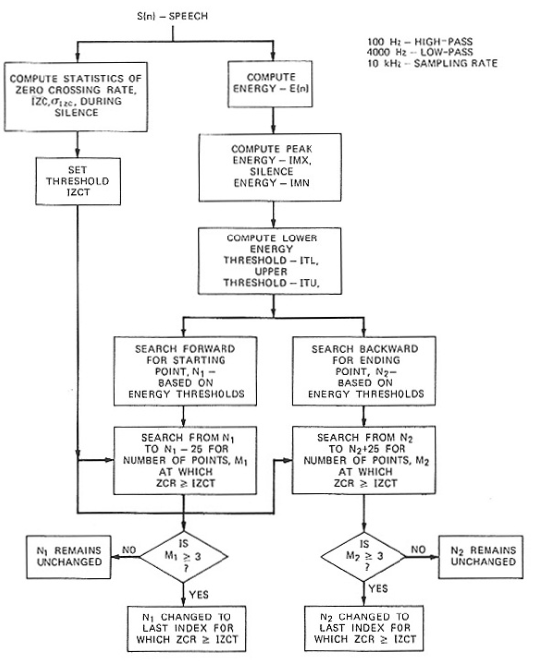
Rabiner’sEndpoint Detection Algorithm

Slide 25
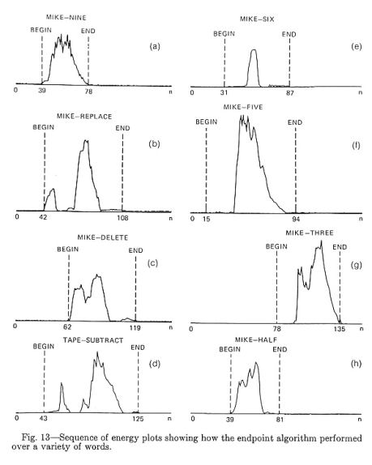
Rabiner Algorithm Performance

Slide 26
Entropy is a possible VAD feature
Entropy: Bits needed to store information
Formula: Computing the entropy for possible values:
Entropy(p₁, p₂, …, p_{n}) = - p₁lg p₁ – p₂lg p₂ … - p_{n} lg p_{n}
Where
p_{i} is the probability of the i^{th} value
log₂x is logarithm base 2 of x
Examples:
A coin toss requires one bit (head=1, tail=0)
A question with 30 equally likely answers requires ∑_{i=1,30}-(1/30)lg(1/30) = - lg(1/30) = 4.907

Slide 27
Use of Entropy as VAD Metric
FOR each frame
Apply an array of band pass frequency filters to the signal
FOR each band pass frequency filter output
energy[filterNo] = ∑_{i=bstart,bend}x[i]²
IF this is an initial frame, noise[filterNo] = energy[filterNo]
ELSE speech[filterNo] = energy[filterNo] – noise[filterNo]
FOR i = 0 to MAX DO total += speech[i]
FOR i = 0 to MAX DO entropy += speech[i]/total * log(speech[i]/total)
IF entropy > threshold THEN return SPEECH ELSE return NOISE
Notes:
We expect higher entropy in noise; speech frames should be structured
Adaptive enhancement: adjust noise estimates whenever encountering a frame deemed to be noise. noise[filterNo] = noise[filterNo] * α + energy[filterNo] * (1 -α) where 0<=α<=1

Slide 28
FILTER BANK Speech Detector
E_{L,0} = sum of all level five energy bands
E_{L,1} = sum of first four level 4 energy bands
E_{L,2} = sum of last five level 4 energy bands + first level 3 energy band
IF E_{L,2} > E_{L,1} > E_{L,0} and E_{L,0}/E_{L,2} < 0.99, THEN frame is unvoiced speech

Slide 29
G 729 VAD Algorithm
Importance: An industry standard and a reference to compare new proposed algorithms
Overview
A VAD decision is made every 10 MS
Features: full band energy, the low band energy, the zero-crossing rate, and line spectral pairs (computed by transforming the linear prediction coefficients).
A long term average of frames judged to not contain voice
VAD decision:
compute differences between a frame and noise estimate.
Adjust difference using average values from predecessor frames to prevent eliminating non-voiced speech
IF differences > threshold, return true; ELSE return false

Slide 30
Non-Stationary Click Detection
Stationary noise has a relatively constant noise spectrum, like a background fan
Compute the standard deviation (σ) of a frame’s LPC residue
Algorithm
FOR each frame (f)
Perform the Linear prediction with C coefficents (c[i])
lpc = Convolution of the frame using the c[i] as a filter
residue energy residue[i] = |lpc[i] – f[i]²
Compute the standard deviation of the residue (σ)
IF K σ > threshold, where K is an empirically set gain factor
Approach 1: Throw away frames determined to contain clicks
Approach 2: Use interpolation to smooth the residue signal of clicks
Definition: Residue – difference between the signal and the LPC generated signal

Slide 31
Experiment
Approach 1: Throw away click frames
Approach 2: Interpolate click frames
Missing [%] | False alarm [%]
0.8 | 14.1
Missing [%] | False alarm [%]
1.9 | 7.3
Music without clicks
Music clicks

Slide 32
Doubly Combined Fourier Transform
Assume the first ten frames are noise
Perform Fourier Transform on each frame
Perform 2nd Fourier Transform on step 1 power amplitudes
Find a center index L = $\frac{\sum_{i=0}^{N−1}{X2[i]}}{\sum_{i=0}^{N−1}{\frac{X2[i]}{i}}}$
Find the best line fit for the bottom part of the X₂ spectrum ${\left[\begin{matrix}a0 \\ a1\end{matrix}\right]=\left[\begin{matrix}\sum_{j=0}^{L−1}{\frac{1}{j}} & \sum_{J=0}^{L−1}{\frac{lg⁡(j)}{j}} \\ \sum_{j=0}^{L−1}{\frac{lg⁡(j)}{j}} & \sum_{J=0}^{L−1}{\frac{\lg\left(j\right)2}{j}}\end{matrix}\right]}^{−1} ∗ \left[\begin{matrix}\sum_{j=0}^{L−1}{\frac{X2[j]}{j}} \\ \sum_{j=0}^{L−1}{\frac{X2[j]}{\lg\left(j\right)∗j}}\end{matrix}\right]$
Do the same for the upper part of the spectrum to compute a2, a3
The distance from a noise frame exceeds a threshold, it is speech.

