Slide 1
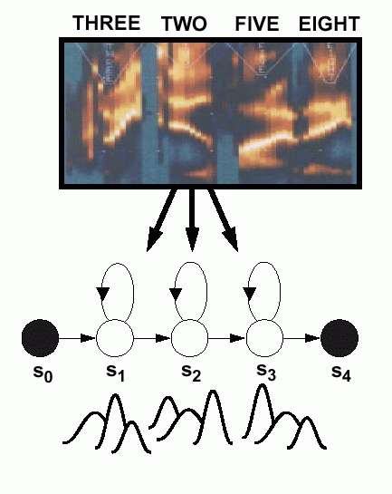
Acoustic Modeling Hidden Markov Models
Acoustic models encode the temporal changes of the features (spectrum).
Gaussian mixture distributions are used to account for variations in speaker, accent, and pronunciation.
Phonetic model topologies are simple left-to-right structures.
Skip states (time-warping) and multiple paths (alternate pronunciations) are also common features of models.
Sharing model parameters is a common strategy to reduce complexity.

Slide 2
HMM Versus DTW
DTW employs audio fixed templates to recognize speech
DTW utilizes a fixed set of possible matching paths between spoken audio and a list of templates
The template with the lowest normalized distortion is most similar to the input and is selected as the recognized word
DTW algorithms can run without training (unsupervised)
HMMs advances DTW technology and employs a probabilistic model
HMM allows all possible paths, but considers their probabilities
The most likely matching word is selected as the one recognized
HMM techniques requires training of the algorithm

Slide 3
Acoustic Modeling: Parameter Estimation
Closed-loop data-driven modeling supervised training from a word-level transcription.
The expectation/maximization (EM) algorithm is used to improve our parameter estimates.
Computationally efficient training algorithms (Forward-Backward) have been crucial.
Batch mode parameter updates are typically preferred.
Decision trees are used to optimize parameter-sharing, system complexity, and the use of additional linguistic knowledge.
Discover the number of hidden states needed to model a word
Initialization
Single
Gaussian
Estimation
2-Way Split
Mixture
Distribution
Reestimation
4-Way Split
Reestimation
•••

Slide 4
Definitions
Stochastic process: A process of change of one or more random variables {Xi} over time based on a well-defined set of probabilities
Markov model: a Markov model consists of a finite list of the possible states of that system, the possible transitions from one state to another, and the rates that govern those transitions. Transitions can depend on the current state and some number of previous states.
Markov Chain
Markov model with a finite number of states in which the probability of a next state depends only upon the current state and the immediate past state
P(w₁, …, w_{n}) ≈ ∏_{i=2,n} P(w_{i} | w_{i-1}) not P(w₁, …, w_{n}) = ∏_{i=2,n} P(w_{i} | w₁, …, w_{i-1})
Markov Assumption
Demonstration of a Stochastic Process
http://cs.sou.edu/~harveyd/classes/cs415/docs/unm/movie.html

Slide 5
Natural Language HMM Assumptions
Discrete: Speech has a finite set of observable states in time steps
Markov Chain: State changes are based solely on state change probabilities of the current state (memoryless)
Output: State and solely depends on the state itself (i.e. a particular sound corresponds to a single phoneme)
Markov Model: Speech processes (e.g. Phoneme sequence) are a Markov process (i.e. one based on Markov chains)
Examples
The next phoneme’s probability depends solely on the preceding one of the sequence
Hidden Markov model, predicting the hidden cause after observing the output models predicting the words, when observing the audio

Slide 6
Markov Example
Problem: Model the Probability of stocks being bull, bear, or stable
Observe: up, down, unchanged
Hidden: bull, bear, stable
a_{ij} | Bull | Bear | Stable
Bull | 0.6 | 0.2 | 0.2
Bear | 0.5 | 0.3 | 0.2
Stable | 0.4 | 0.1 | 0.5
Probability Matrix
bull
bear
 | Ω_{i}
Bull | 0.5
Bear | 0.2
Stable | 0.3
stable
Initialization Matrix
Example: What is the probability of observing up five days in a row?

Slide 7
Hidden Markov Model
Motivation
We observe the output
We don't know what internal states the model is in
Goal: Determine the most likely internal (hidden) state
Hence the title, “Hidden”
Definition (Discrete HMM Ф = [O, S, A, B, Ω]
O = {o₁, o₂, …, o_{M}} is the possible output states
S = {1, 2, …, N} possible internal HMM states
A = {a_{ij}} is the transition probability matrix from state i to j
B = {b_{i}(k)} probability of state i outputting o_{k}
{Ω _{i}} = is a set of initial State Probabilities where Ω_{i} is the probability that the system starts in state i

Slide 8
Maximum Likelihood Formulation

Slide 9
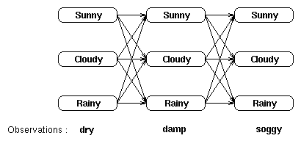
Example
Goal: Find the probability of an observed sequence
Consider HMM describes weather and it relates to seaweed states
We have a sequence of seaweed observations.
The HMM describes: All possible weather state for each observation
Initial State: The probability of being in state j at initialization is that state's probability times the probability of the observation

Slide 10
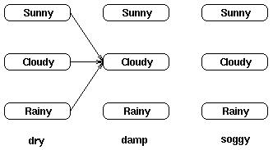
Paths to cloudy in observation two
We can calculate the probability of reaching an intermediate state in the trellis as the sum of all possible paths to that state
The probability of it being cloudy at t = 2 is calculated from the following paths
P(cloudy at t=2) = P(damp | cloudy) x P(all paths to cloudy at time t=2)

Slide 11
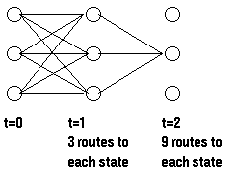
Dynamic Algorithm Next Step
We can assume that the probability of observation versus weather is always available
The probability of getting to a state through all incoming paths is also available because of the dynamic programming approach
Notice that we have an expression to calculate at time t+1 using only the partial probabilities at time t. This greatly reduces the total complexity of the calculation
Demo: http://www.comp.leeds.ac.uk/roger/HiddenMarkovModels/html_dev/hmms/s3_pg1.html

Slide 12
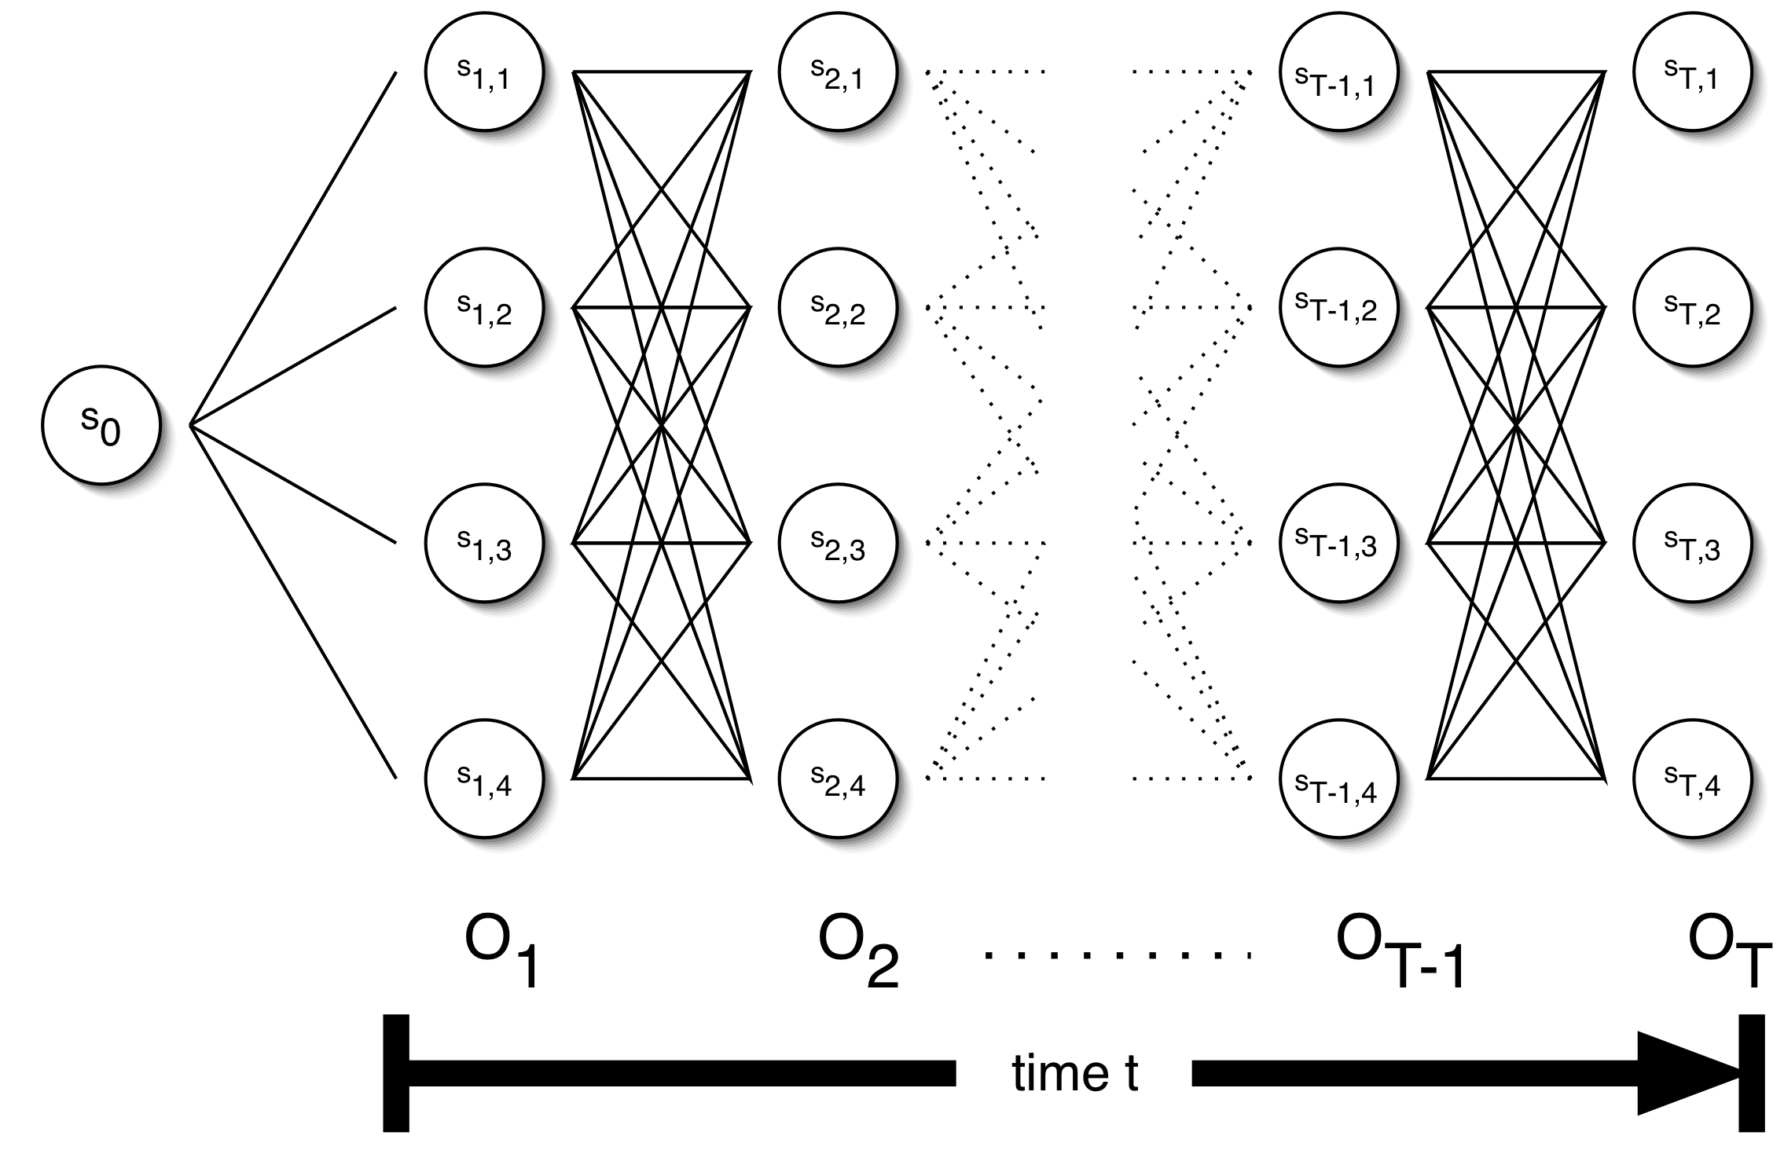
HMM: Trellis Model
Question: How do we find the most likely sequence?

Slide 13
Probabilities
Forward probability: $α_{t}(i)$
The probability of being in state s_{i}, given the partial observation o₁,…,o_{t}
Backward probability: $β_{t}(i)$
The probability of being in state s_{i}, given the partial observation o_{t+1},…,o_{T}
Transition probability: α_{ij} = P(q_{t} = s_{i}, q_{t+1} = s_{j} | observed output)
The probability of being in state s_{i} at time t and going from state s_{i}, to state s_{j}, given the complete observation o₁,…,o_{T}

Slide 14
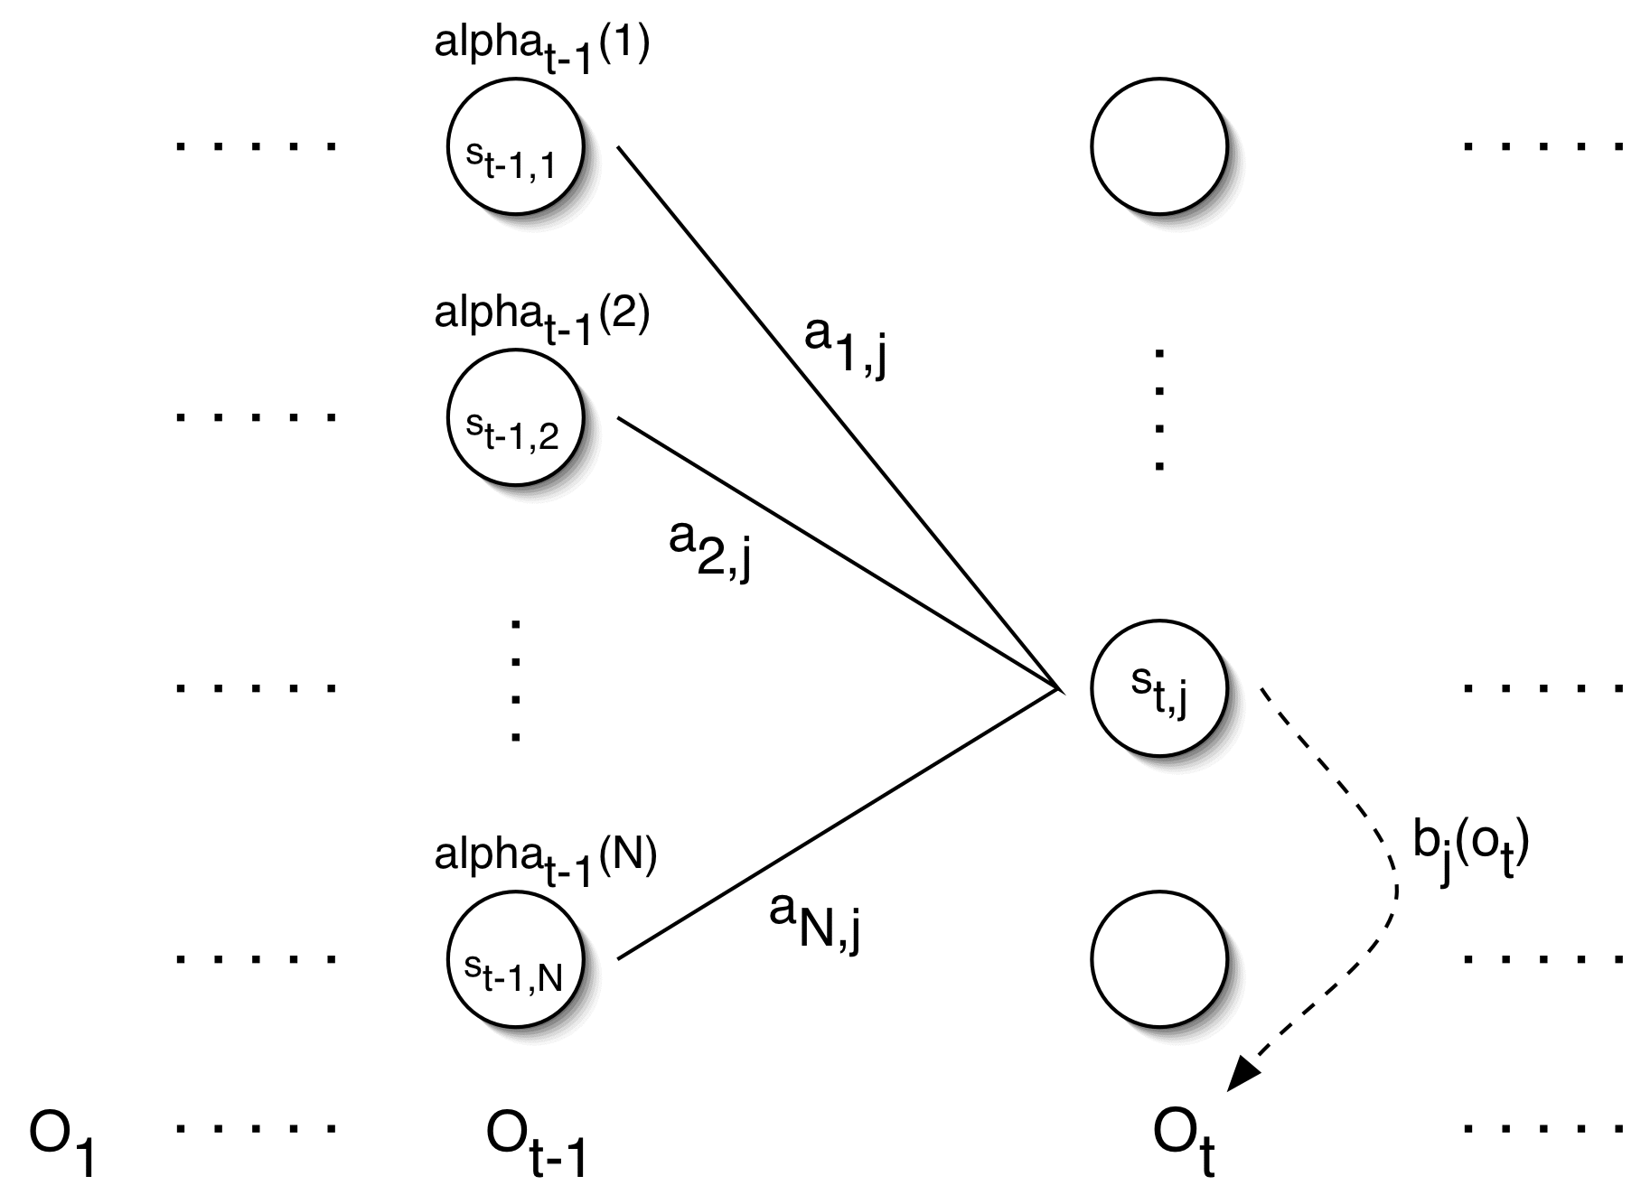
Forward Probabilities
α_{t}(j) = ∑_{i=1,N} {α_{t-1}(i)α_{ij}b_{j}(o_{t})} and α_{t}(j) = P(O₁…O_{T} | q_{t} = s_{j}, λ)
Notes
λ = HMM, q_{t} = HMM state at time t, s_{j} = j^{th} state, O_{i} = i^{th} output
a_{ij} = probability of transitioning from state s_{i} to s_{j}
b_{i}(o_{t}) = probability of observation o_{t} resulting from s_{i}
α_{t}(j) = probability of state j at time t given observations o₁,o₂,…,o_{t}

Slide 15
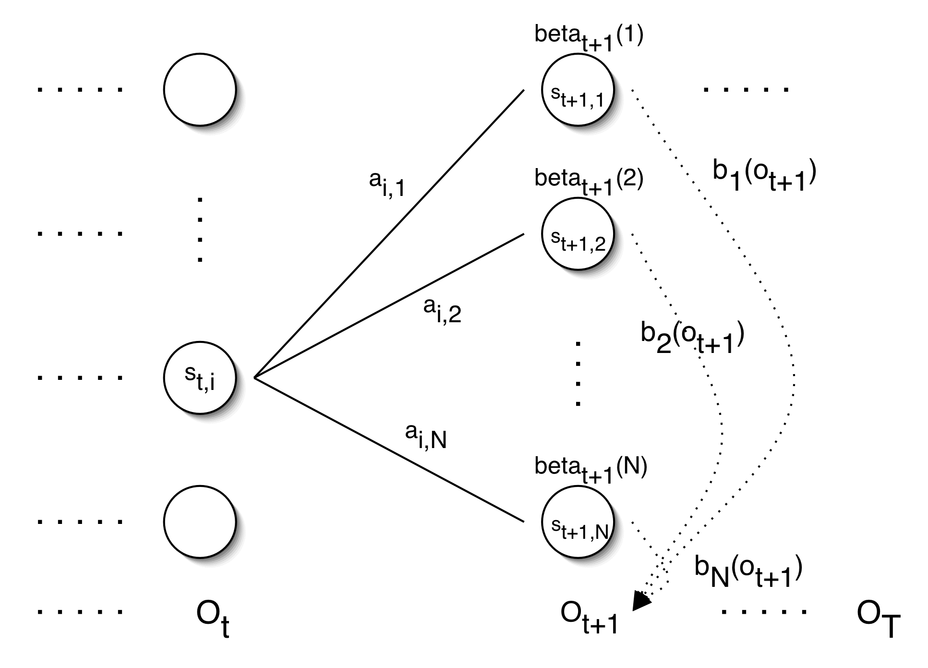
Backward Probabilities
β_{t}(i) = ∑_{j=1,N} {β_{t+1}(j)α_{ij}b_{j}(o_{t+1})} and β_{t}(i) = P(O_{t+1}…O_{T} | q_{t} = s_{i,} λ)
Notes
λ = HMM, q_{t} = HMM state at time t, s_{j} = j^{th} state, O_{i} = i^{th} output
a_{ij} = probability of transitioning from state s_{i} to s_{j}
b_{i}(o_{t}) = probability of observation o_{t} resulting from s_{i}
β_{t}(i) = probability of state i at time t given observations o_{t+1},o_{t+2},…,o_{T}

Slide 16
The Three Basic HMM Problems
Given: observation sequence O=o1,…,on and an HMM model
Problem 1 (Evaluation): What is the probability of observation O?
Problem 2 (Decoding): What state sequence best explains O?
Problem 3 (Learning): How do we adjust the HMM parameters for it to “learn” to best predict O based on the sequence of states?
Demo:
www.comp.leeds.ac.uk/roger/HiddenMarkovModels/html_dev/hmms/s3_pg1.html

Slide 17
Problem 1: Evaluation
Calculate observation sequence probability
Algorithm: sum probabilities of all possible state sequences that can occur in the HMM, which lead to a particular state
Naïve computation is very expensive
Given T observations and N states, there are N^{T} possible state sequences.
If T=10 and N=5, there are 5¹⁰ possible state sequences
Solution: Use dynamic programming

Slide 18
Forward Probabilities
Assume
λ is the automata, which is a pronunciation network for each candidate word
o₁,o₂,…,o_{t} is an observation sequence of length t
Forward[t,j] = P(o₁,o₂,…,o_{t},qεQ| λ) * P(w)
This answers the question:
What is the probability that, given the partial observation sequence o₁,o₂,…,o_{t}, and an HMM, λ, we arrive at state q?

Slide 19
HMM Example
a_{ij} | 1 | 2 | 3
1 | 0.6 | 0.2 | 0.2
2 | 0.5 | 0.3 | 0.2
3 | 0.4 | 0.1 | 0.5
O = {up, down, unchanged (Unch)}
S = {bull (1), bear (2), stable (3)}
B_{i} | up | down | Unch.
1 | 0.7 | 0.1 | 0.2
2 | 0.1 | 0.6 | 0.3
3 | 0.3 | 0.3 | 0.4
1
2
3
State | Ω_{i}
1 | 0.5
2 | 0.2
3 | 0.3
Observe 'up, up, down, down, up'
What is the most likely sequence of states for this output?

Slide 20
Forward Probabilities
A_{i,c} | 0 | 1 | 2
0 | 0.6 | 0.2 | 0.2
1 | 0.5 | 0.3 | 0.2
2 | 0.4 | 0.1 | 0.5
X = [up, up]
B_{i}*Ω_{c} = 0.7 * 0.5
0.35
0.179
b_{c} | up | down | Unch.
0 | 0.7 | 0.1 | 0.2
1 | 0.1 | 0.6 | 0.3
2 | 0.3 | 0.3 | 0.4
0.02
0.009
State | Ω_{c}
0 | 0.5
1 | 0.2
2 | 0.3
0.09
0.036
t=0
t=1
Sum of α_{0,c} * a_{i,c} * b_{c}
Note: 0.35*0.2*0.3 + 0.02*0.2*0.3 + 0.09*0.5*0.3 = 0.0357

Slide 21
Forward Algorithm Pseudo Code
What is the likelihood of a word given an observation sequence?
forward[i,j]=0 for all i,j; forward[0,0]=1.0
FOR each time step t
FOR each state s
FOR each state transition s to s’
forward[s’,t+1] += forward[s,t]*a(s,s’)*b[s’,o_{t}]
RETURN ∑forward[s,t_{final+1}] for all states s
Notes
1.a(s,s’) is the transition probability from state s to state s’
2.B(s’,o_{t}) is the probability of state s’ given observation o_{t}
Complexity: O(t*|S|²) where |S| is the number of states
Question: What if T=10 and N=10?

Slide 22
Problem 2: Decoding
Problem 1: probability of a particular observation sequence
Problem 2: most likey path through the HMM
Algorithm: similar to computing the forward probabilities
instead of summing over transitions from incoming states
compute the maximum

Slide 23
Viterbi Algorithm
Similar to computing the forward probabilities, but instead of summing over transitions from incoming states, compute the maximum
Forward:
Viterbi Recursion:

Slide 24
Viterbi Example
A_{i,c} | 0 | 1 | 2
0 | 0.6 | 0.2 | 0.2
1 | 0.5 | 0.3 | 0.2
2 | 0.4 | 0.1 | 0.5
B_{i}*Ω_{c} = 0.7 * 0.5
Observed = [up, up]
0.35
0.147
State 0
b_{c} | up | down | Unch.
0 | 0.7 | 0.1 | 0.2
1 | 0.1 | 0.6 | 0.3
2 | 0.3 | 0.3 | 0.4
State 1
0.02
0.007
State | Ω_{c}
0 | 0.5
1 | 0.2
2 | 0.3
State 2
0.09
0.021
t=0
t=1
Maximum of α_{0,c} * a_{i,c} * b_{c}
Note: 0.021 = 0.35*0.2*0.3, versus 0.02*0.2*0.3 and 0.09*0.5*0.3

Slide 25
Viterbi Algorithm Pseudo Code
What is the likelihood of a word given an observation sequence?
viterbi[i,j]=0 for all i,j; viterbi[0,0]=1.0
FOR each time step t
FOR each state s
FOR each state transition s to s’
newScore=viterbi[s,t]*a(s,s’)*b[s’,o_{t}]
IF (newScore > viterbi[s’,t+1]) viterbi[s’,t+1] = newScore maxScore = newScore
save maxScore in a queue
RETURN queue
Notes
1.a(s,s’) is the transition probability from state s to state s’
2.B(s’,o_{t}) is the probability of state s’ given observation o_{t}

Slide 26
Problem 3: Learning
What if we don’t know the underlying HMM?
Speech applications normally uses training data to configure the HMM (λ)
Difficulties
Setting up the parameters are difficult and/or expensive
Training data is different from the live data
Sufficient training data might not be available
We want to create a model that learns and adjusts its parameters automatically
Goal: Create λ’ from λ such that P(O| λ’) > P(O| λ)
The optimal solution to this problem is NP complete, but there are heuristics available.

Slide 27
Probabilities
Forward probability:
The probability of being in state s_{i}, given the partial observation o₁,…,o_{t}
Backward probability:
The probability of being in state s_{j}, given the partial observation o_{t+1},…,o_{T}
Transition probability:
The probability of being in state s_{i} at time t and going from state s_{i}, to state s_{j}, given the complete observation o₁,…,o_{T}

Slide 28
Joint probabilities
State i at time T and J at time T+1

Slide 29
Parameter Re-estimation
Three parameters need to be re-estimated:
The probabilities of the initial states
Transition probabilities between states: a_{i,j}
Probabilities of output (o_{t}) from state i: b_{i}(o_{t})
The forward-backward (Baum-Welch) maximum likely estimation (MLE) is a hill climbing algorithm
Iteratively re-estimate parameters
Improves probability that an observation matches data until the algorithm converges

Slide 30
Expectation Maximization (EM)
The forward-backward algorithm is an instance of the more general EM algorithm
The E Step: Compute the forward and backward probabilities for a give model
The M Step: Re-estimate the model parameters
Continue until the calculations converge

Slide 31
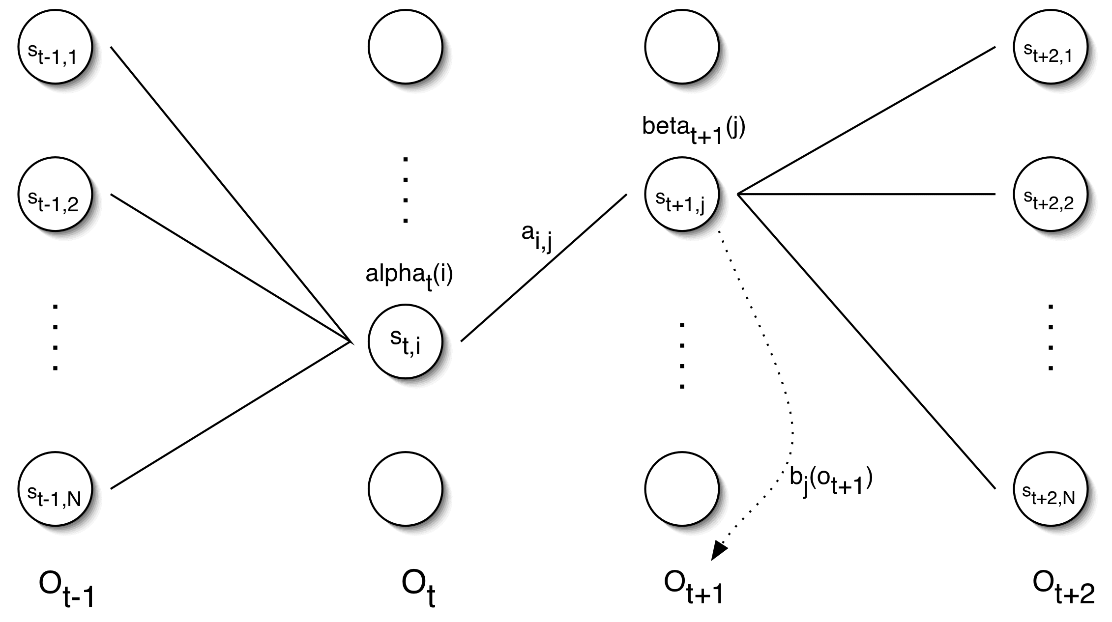
Re-estimation of State Changes
Forward Value
Note: b(o_{t}) is part of α_{i}(t)
α’_{ij} = ∑_{t=1,T} α_{t}(i)α_{ij}b(o_{t+1}) β_{t+1}(j)
Backward Value
∑_{t=1,T} α_{t-1}(i)β_{t-1}(i)
Sum transitions from state, i, to state, j, divided by transitions out of state i

Slide 32
Re-estimating Transition Probabilities
ξ(i,j) = P(state s_{i} at t and s_{j} at t+1, emitting o_{t+1} given o₁,…,o_{T} and HMM λ
Recall: a_{ij,} b_{i}(o_{t+1}) are HMM λ state transition and state emit probabilities
Recall: α_{t}(i) is the probability of getting to state i using observations o₁,…,o_{t}
Recall: β_{t}(i) is the probability of getting to state i using observations o_{T},…,o_{t+1}
Note: a_{ij}*b_{j}(o_{t}+1)*α_{t}(i)*β_{t}(i) estimates the probability to transition from i to j at t
Note: Division by all possible transitions normalizes to a value between 0 and 1
Note the calculation components in the diagram on the right

Slide 33
Re-estimating Transition Probabilities
The intuition behind the re-estimation equation for transition probabilities is
$$\frac{expected transitions from state s_{i} to s_{j}}{total expected transitions from state s_{i}}$$
Formally:
T
∑
ξ
(
i
,
j
)
=
t-1
t
=
1
T
−
1
∑
γ
(
i
)
t-1
t
=
1
Note: γ_{t}(i) is the probability of being in state s_{i} at time t, given o₁,o₂,…o_{T}

Slide 34
Re-estimating Initial State Probabilities
Initial state distribution:
is the original probability that s_{i} is a start state
Re-estimated initial state distribution:
Formally:
π
=
ˆ
Probability that s_{i} is a start state at time 1 given o₁,o₂,…o_{T}
i

Slide 35
Re-estimation of Emission Probabilities
The likelihood of an output being observed from a given state
Re-estimation of Emission probabilities
Formally:
Where
Note that δ here is not related to the δ in the discussion of the Viterbi algorithm!!
ˆ
expected number of times in state s
and observe symbol o
b
(
o_{k}
)
=
i
k
i
expected number of times in state s
i
T
∑
δ
(
o
,
v
)
γ
(
i
)
ˆ
t
k
t
b
(
o_{k}
)
=
t
=
1
i
T
∑
γ
(
i
)
t
t
=
1

Slide 36
Computing the New HMM Model λ’
Original HMM λ having
Probability of transition from state i to j: a_{i,j}
Probability of state i Emitting output o_{k}: b_{i}(o_{k})
Probability of state i being an initial state:
The Revised HMM λ’ having
Iterate until the parameters converge for all i, j, and k
ˆ
π
=
γ
(
i
)
i
1

Slide 37
Extension for gaussian output
$b_{j}\left(o\right)=G(o, u,$∑) = $\frac{1}{\sqrt{{\left|∑\right|(2π)}^{n}}}exp⁡(−\frac{1}{2}(o−u)$ ∑⁻¹(o-u))
Update covariance matrix
$${cov′}_{j,k}= \frac{\sum_{t=1}^{T}{γ_{t}}\left(j,k\right)∗\left(ot−ujk\right)\left(ot−ujk\right)T}{\sum_{t=1}^{T}{γ_{t}(j,k)}}$$
Update mean
${u′}_{j,k}$= $\frac{\sum_{t=1}^{T}{{γ_{t}\left(j,k\right).O}_{t}}}{\sum_{t=1}^{T}{ γ_{t}{(j,k)}_{}}}$
∑ is a common symbol for covariance matrix, ∑⁻¹ is its inverse, | ∑| is its determinant
The superscript, T indicates the transpose

Slide 38
Coin Flips Example
Two trick coins used to generated a sequence of heads and tails
You see only the sequence, and must determine the probability of heads for each coin
Coin A
Coin B

Slide 39
10,000 Coin Flips
Real coins
P_{A}(heads) = 0.4
P_{B}(heads) = 0.8
Initial guess
P_{A}(heads) = 0.51
P_{B}(heads) = 0.49
Learned model
P_{A}(heads) = 0.413
P_{B}(heads) = 0.801
Conergence between iterations
1
10
20
30
40
Iteration

Slide 40
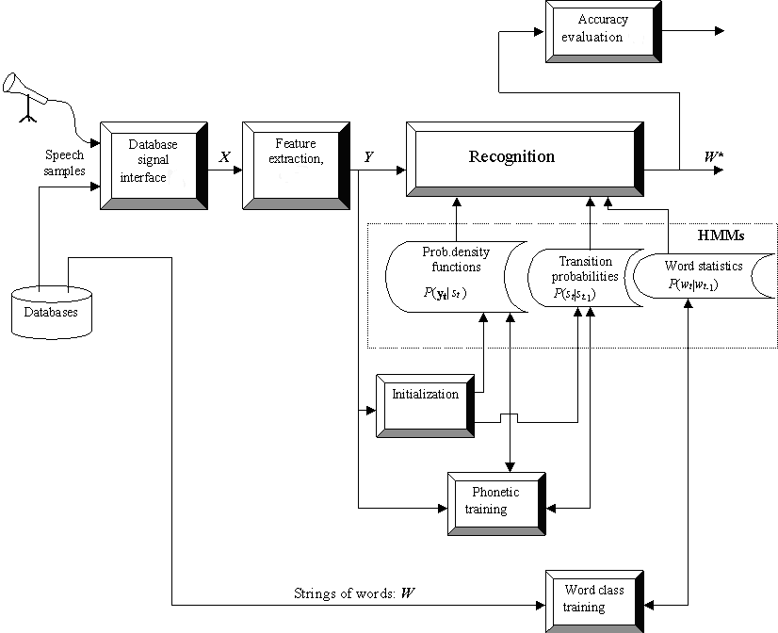
ASR Architecture
HMM Initialisation and Training

Slide 41
HMM in Computational Linguistics
Speech Recognition:
What words generated the observed acoustic signal?
Where are the word/phoneme/syllable boundaries in an acoustic signal?
Handwriting Recognition: Which words generated the observed image?
Morphology:
Which parts of speech correspond to the observed words?
Where are the word boundaries in the acoustic signal?
Which morphological word variants match the acoustic signal?
Translation: Which target language words correspond to foreign words?

Slide 42
Bayes' Rule
Fundamental to HMM speech recognition algorithms
P(A | B) = P(B | A)*P(A) P(B)
P(B) = ∑_{k=1,n} P(B | A_{k}) * P(A_{k})
P(A_{i} | B) = P(B|A_{i})P(A_{i}) ∑_{k=1,n} P(B | A_{k}) * P(A_{k})
B
A₃
A₂
A₄
B
A₁
A₅
Max [P(word | sound)] = Max [P(sound | word) * P(word) / P(sound)]
= Max [P(sound | word) * P(word)] because the denominator is a constant

Slide 43
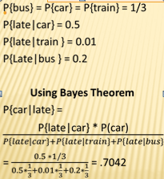
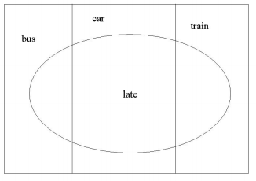
Bayes Example
Probability that a car will be late to its destination

Slide 44
Bayesian Inference
4 Vegetarians
3 CS majors
Randomly choose students from population of ten. Find probabilities:
p(vegetarian) = .4, p(cs major) = .3
Student vegetarian is a CS major? p(c|v) = .5 = p(c) p(v|c) / p(v)
Student is a vegetarian and CS major? p(c,v) = .2 = p(v) p(c|v)
Student vegetarian and CS major? p(c,v) = .2 = p(c) p(v|c)
Student CS major is a vegetarian? p(v|c) = .66 = p(v) p(c|v) / p(c)

Slide 45
Noisy Channel Decoding
Source
Noisy Channel
Decoder
Assume Input=word w; Feature vector=f, V=vocabulary
We want to find the word, w = max _{wεv} p(w|f)
Using Bayes Rule: max_{wεv} p(f|w)p(w)/p(f)
Why use Bayes Rule?
P(w|f) is difficult to compute
P(f|w) is relatively easy to compute. Just add probabilities to reflect spelling or pronunciation variation rules
P(w) is how often w occurs in a large corpus (prior priority)
Ignore P(f). f doesn’t change as we search the lexicon.

Slide 46
Speech Recognition Example
Observations: The digital signal features
Hidden States: The spoken word that generated the features
Simplifying Assumption: We know the acoustic signal word boundaries
Goal: Assume Word Maximizes P(Word|Observation)
Bayes Law simplifies the calculations:
P(Word|Observation) = P(Word) P(Observation|Word)/P(O)
Ignore denominator: it’s probability = 1 (we observed it after all)
Note: It is easier to compute acoustic variations in saying a word, than computing all possible acoustic observations
P(Word) can be looked up from a database
Use bi or tri grams to take the context into account
Chain rule: P(w) = P(w₁)P(w₂|w₁)P(w₃|w₁,w₂)P(w,w₁w₂…w_{G})
Use smoothing algorithms to insert non-zero values if needed

Slide 47
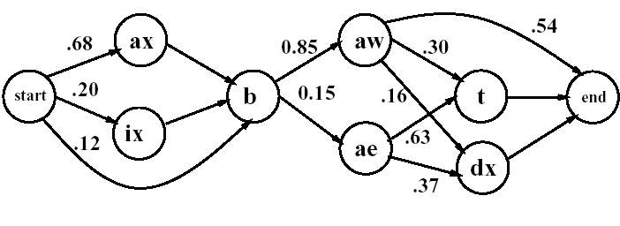
A Word based HMM
HMM for the word ‘about’
Definition:
States Q = {start, ax, ix, b, aw, ae, t, dx, end}
Transition probabilities T = {.68, .20, .12, .85, .15, .16, .63, .37, .30, .54}
Non-emitting states: start and end.
The states are nodes, and the transitions are edges
The actual symbols seen are the observation sequence

Slide 48
Parameters for HMM states
Cepstrals
Why? They are largely statistically independent which make them suitable for classifying outputs
Delta coefficients
Why? To overcome the HMM limitation where transitions only depend on one previous state. Speech articulators change slowly, so they don’t follow the traditional HMM model. Without delta coefficients, HMM tends to jump too quickly between states
Synthesis requires more parameters than ASR
Examples: additional delta coefficients, duration and F0 modeling, acoustic energy

Slide 49
Training Data
Question: How do we establish the transition probability between states when that information is not available
Older Method: tedious hand marking of wave files based on spectrograms
Optimal Method: NP complete is intractable
Newer Method: HMM Baum Welsh algorithm is a popular heuristic to automate the process
Strategies
Speech Recognition: train with data from many speakers
Speech Synthesis: train with data for specific speakers

Slide 50
Scoring Acoustic Features
Choose the model: discrete, continuous, semi-continuous
Continuous: Insufficient training data
Consider discrete ranges of values
Problem: difficult to determine boundaries between ranges
Discrete or semi-continuous
Consider multiple codebooks
Multiple codebooks require HMM formulas adjustments
For example: α_{t,i} = ∑_{i=0,N-1} α_{t-1,i}a_{i,j} ∏ b_{j}(x_{t})
Decide whether to use a word or sub word model
Word model: collect training data for each word
Sub-word models: share the subunits across the vocabulary

Slide 51
HMM limitations
HMM is a hill climbing algorithm
It finds local (not global) minimums, not global minimums
It is sensitive to initial parameter settings
HMM's have trouble modeling variable phoneme lengths
The first order Markov assumption is not quite correct
Underflows occur when multiplying probabilities. For this reason, log probabilities are normally used
HMM requires a fixed number of state changes, which doesn’t easily convert to a continuous range of values
The relationship between outputs are interrelated, not independent

